Slide 1
Reno, Nevada

Slide 2
The meat of the conference…
Sample breakout sessions….
Great programs at meals…
Starting Interact Clubs
Attracting young professionals
Membership
Youth Exchange
Fund raising/accountability
Use of social media
Leadership development
Dave Dravecky SF Giants
Lisa Kristine-human slavery
Mike McGuire-state senator
Brenda Cressey, Chair, TRF
Jim Marggraff-Global Citizen
Background on speakers
Click here for complete
list of breakout sessions, handouts.

Slide 3
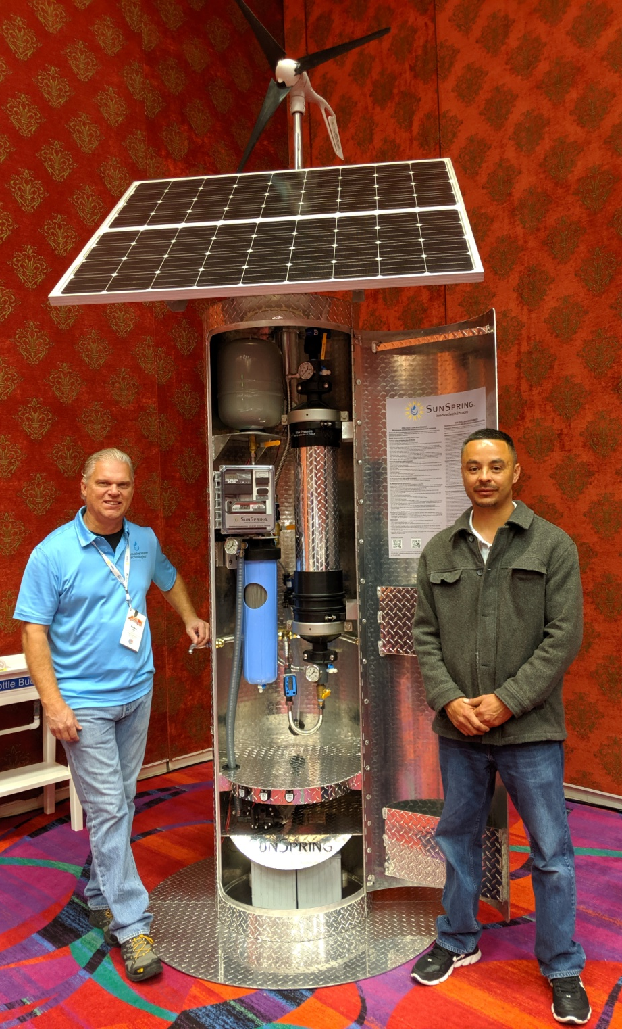
H2OpenDoors
~$29k gets a self sustained water filtration system. Villagers can make $100k/yr selling clean, filtered water at 3 cents/liter.
H2OpenDoors.org

Slide 4
IVV Zimba Eye Clinic in Zambia ($120k)
Orinda Rotary Global Grant project, seeking addnl $20k.
Project provides off-grid solar power for clinic, allowing year round operation (funding for power currently restricts operation to several months /yr.)

Slide 5
A coaching, mentoring program, min 2 hrs/month, has shown dramatic results. Graduates eligible for micro-loans and Wheels2Work program.
Rotary Clubs of Reno and Sparks bridgesnv.org

Slide 6
Outreach via Virtual Reality
There is an RI resource that we can personalize for prompting our club/programs.
Resources:
Lamorinda Club (J Marggraff, H. Englehart)
NorCal Gateway Club (J. Yuan, M. Chang)

Slide 7
Fully funded scholarship to one of 6 universities around the world. Masters Degree in Peace and Conflict Resolution.
A life changing experience.

Slide 8
Human Slavery and Sex Trafficking.
Resources for education programs in schools.

Slide 9
Fellowships!!!
There are 100’s of them ; something to appeal to everyone.’
From “beer” to “world travel”.

Slide 10
The Rotary Club of Nsambya, Uganda presented projects they are seeking funding for…

Slide 11
Rotary Clubs help seniors…
Clubs provide basic maintenance and repair work (often as simple as changing a light bulb, fixing a broken drawer or leaking facet, batteries on fire alarms).
Two person teams.
Get waiver signed first…
Advertised through MoW’s, senior centers, newspaper.

Slide 12
Footsteps Interact Club 5th grade through Middle School

Slide 13
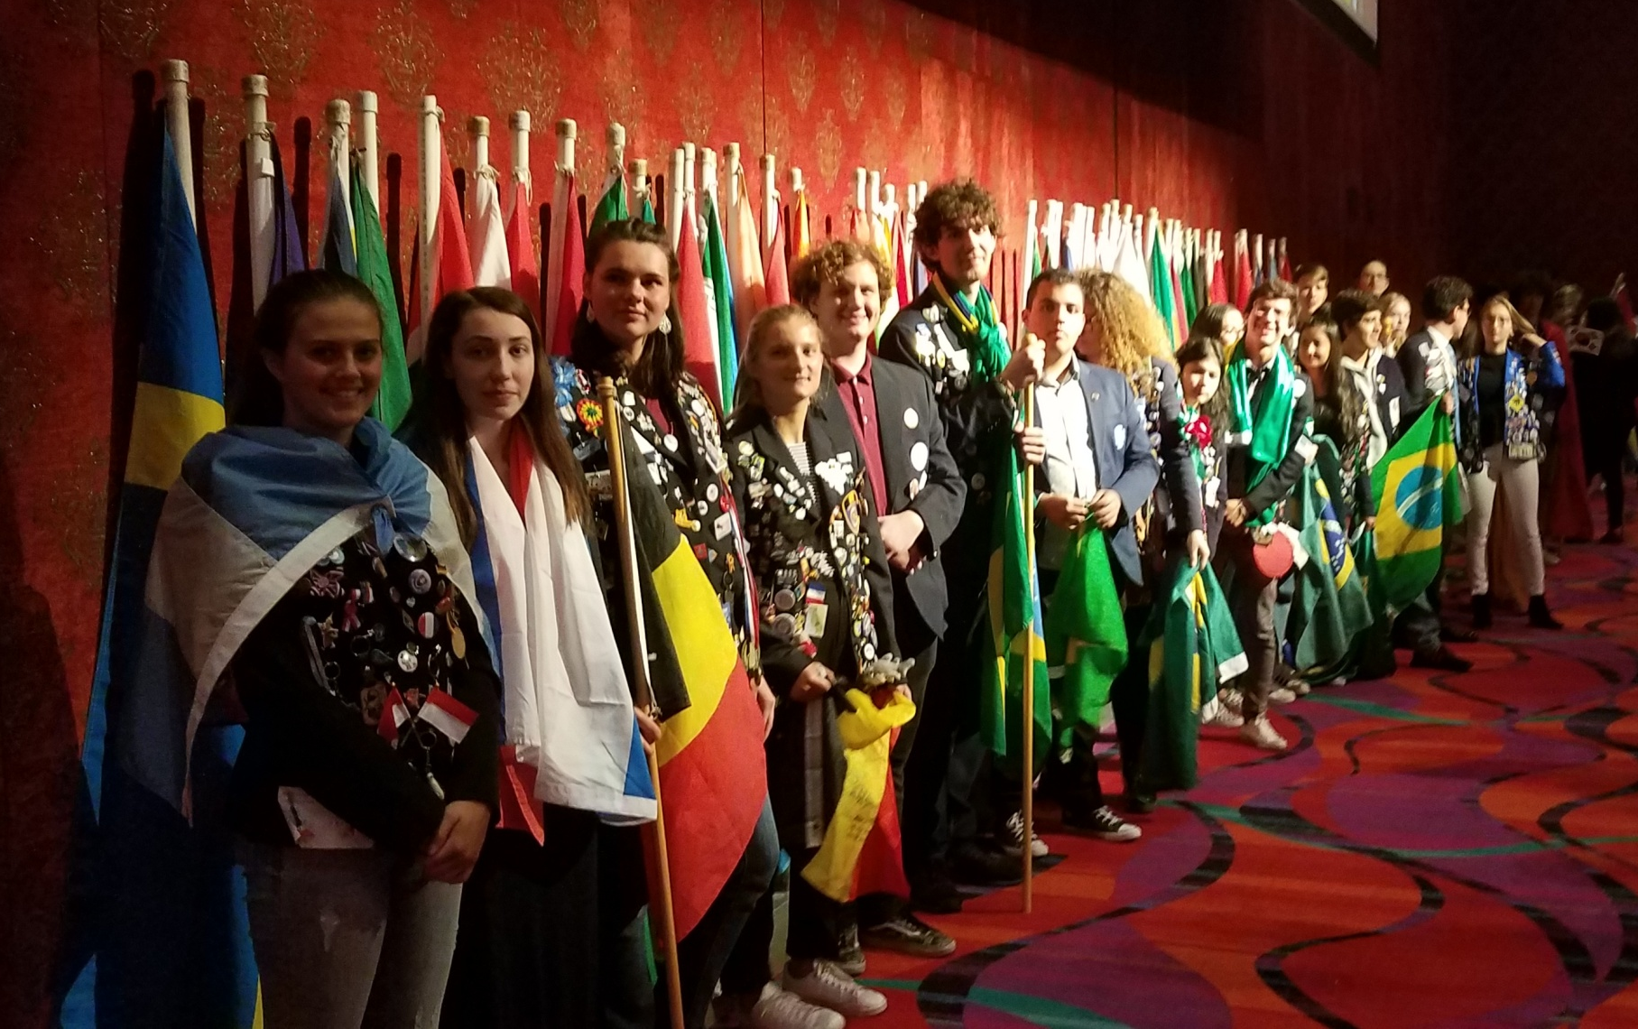
Incredible energy from the Youth Exchange students Incoming and Outgoing…

Slide 14
The fun and fellowship…
Hospitality suites
Receptions
House of Friendship
Karaoke for Polio
Poker for Polio
Service Project: Rise against Hunger
Polio Walk
Youth Music/speech contest winners
Slots tournament
Youth Exchange program

Slide 15
Coming up in 2020
PASSPORT TO ADVENTURE - May 1-3, 2020 Redding Civic Auditorium, and the beautiful Sheraton Redding Hotel at the Sundial Bridge

