Slide 1
Welcome to The Rotary Club of Woodland
The best darn Club in the World !! Today is July 11, 2023

Slide 2
The Pledge of Allegiance

Slide 3
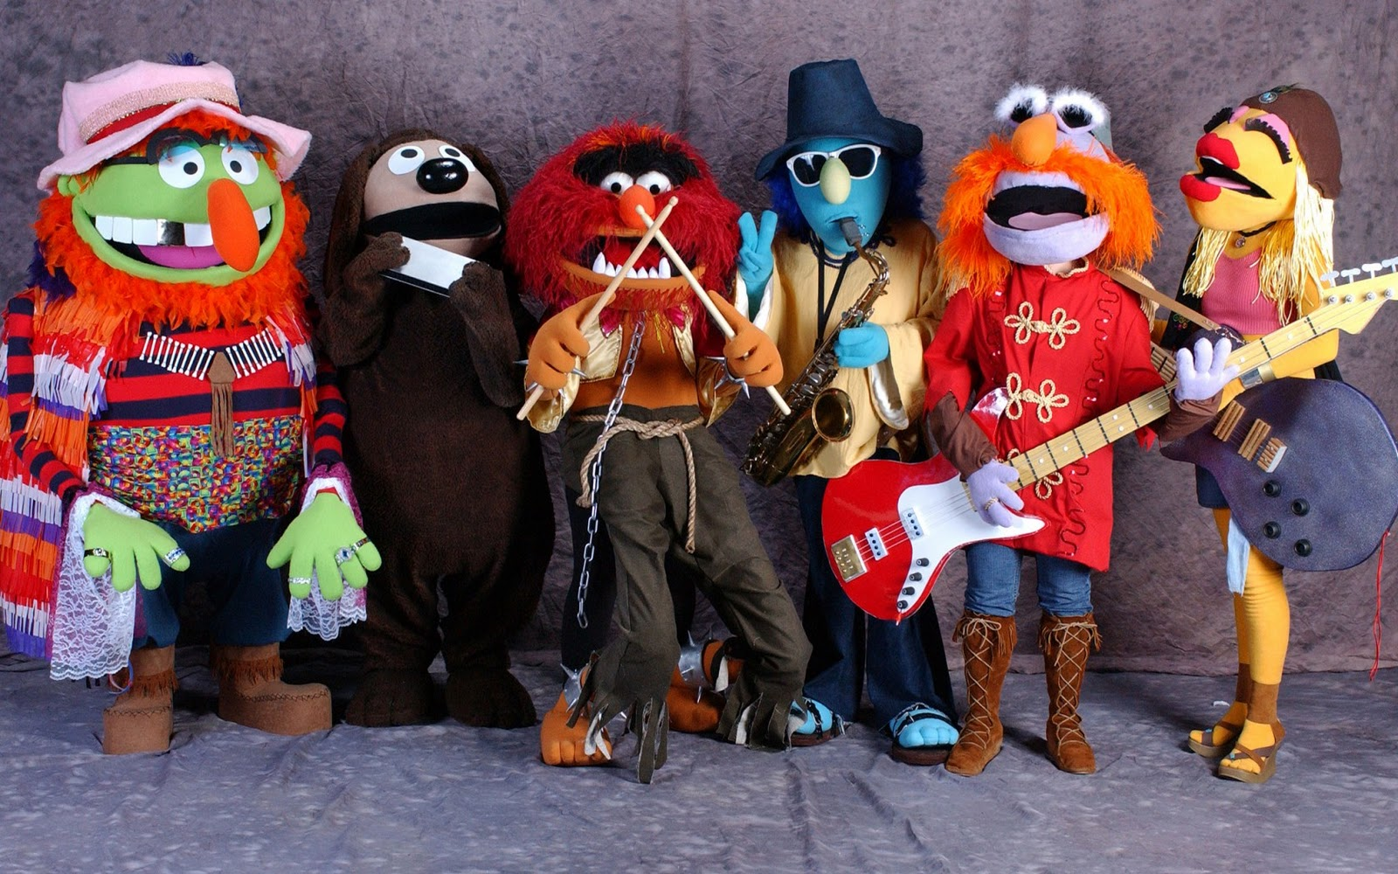
Rotary Grace Singers

Slide 4
Thanks to Sgt at Arms Team
For Room Set-up and Collections today and every meeting day!

Slide 5
Visiting Rotarians Guests of Rotarians
Visiting Rotarians and Guests

Slide 6
Announcements
San Francisco Giants vs. Boston Red Sox July 29, 2023
Beer Booth – Mike Russell

Slide 7
Let’s Celebrate
Birthdays
Seth Wurzel - July 6
Anniversaries
Carl Rodegerdts & June - July 1
Chuck Maltese & Joyce – July 7
Rodger Kohlmeier & Judy – July 10
Gary Wegener & Joanie - July 10
Dan Stroski & Ginny - July 18

Slide 8
MEALS ON WHEELS July 6 Aniek Pflager July 13 Les Engelmann TECHNOLOGY David Pinto Nick Roncoroni Preston Schaub
Special Thanks goes Out To

Slide 9
Immediate Past President Shawn Seyk for a great year of Rotary Fellowship, Fun, and Engagement
Special Thanks goes Out To

Slide 10
“If you can dream it, you can do it.”
Who said?
Walt Disney

Slide 11
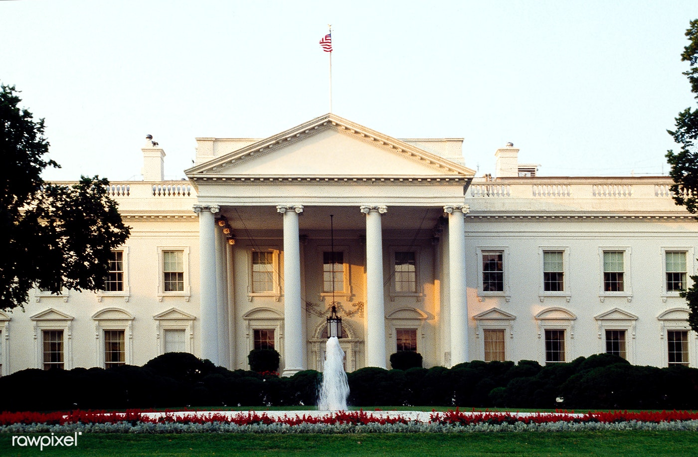
Recognition this week is presented by
Gary Bunch

Slide 12
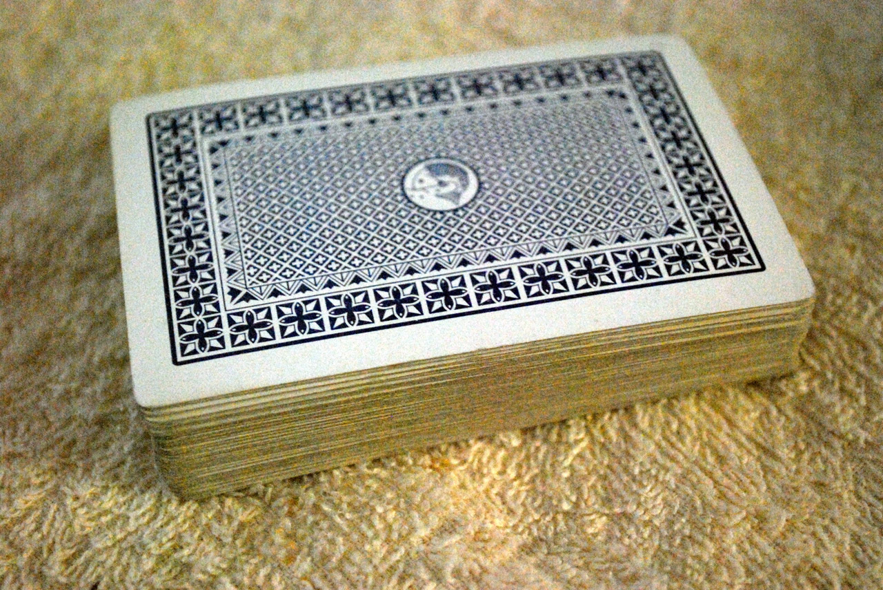
50/50 Drawing

Slide 13
This Week’s Program
zsz
President Karl Diekman will discuss the year ahead

Slide 14
What is My Rotary Experience?
Journey
Networking
Community Service
Leadership Training and Development
Fellowship
Project Planning and Execution
Financial Strategies
International Collaboration

Slide 15
Rotary International 2023 - 24
Theme – “Create Hope in the World”
2023-24 Rotary International President R. Gordon R. McInally Rotary Club of South Queensferry West Lothian, Scotland | Zone 26-27 Director Daniel Himelspach Denver Mile High Rotary Club District 5160 Governor Claire Roberts Lamorinda Sunrise Rotary Club

Slide 16
Woodland Dinner and Auction Donations
Thanks to the generosity of our members and guests we can support several organizations this year
The Bike Campaign Friends of Yolo Adult Day Health MOASIC Children’s Museum | Yolo Crisis Nursery Yolo County Fair Improvement Project All Leaders Must Serve Woodland Little League

Slide 17
RC Woodland Board of Directors
President - elect: Bob Nakken
Secretary: Aniek Pflager
Treasurer: Tom Schwarzgruber
Directors: 2022 - 24 Bob Nakken Brian Dwyer Yvette Roy
2023 - 25 Wendy Casas-Raviotta Lisa Martinez Dunham
Eric Zane
Immediate Past President: Shawn Seyk

Slide 18
AD HOC Committee Chairs
Sergeant at Arms: Tabb Randolph
Meals on Wheels: Jeff Burger
Senior BBQ: Aniek Pflager

Slide 19
Standing Committees
Grants and Service Committee - Blair Voelz
Fundraising Committee - Tabb Randolph
Membership Committee - Yvette Roy
Club Public Relations Committee - Kris Kristensen
Club Administration Committee - Gary Bunch
The Rotary Foundation Committee - Tom Schwarzgruber

Slide 20
Grants and Service Committee
Youth Service Sub Committee
Literacy Sub Committee
Community Service Sub Committee
International Service Sub Committee
Vocational Service Sub Committee

Slide 21
Fundraising / Membership Committees
Fundraising:
Annual Dinner Sub Committee
Beer Booth Sub Committee
Membership:
Membership

Slide 22
Club Public Relations and Club Administration Committees
Club Public Relations Committee:
Public Relations Committee
Club Administration Committee:
Newsletter Sub Committee
Website Sub Committee
Back Table Sub Committee
Recognition Sub Committee
Technology Sub Committee
Programs Sub Committee

Slide 23
Goals for 2023-24
62 members at year end
Maintain 1 member Rotary Action Group participation
3 Club members attend the District Conference
3 Committee Chairs attend the District Assembly
Review and update as appropriate the club by laws

Slide 24
Goals for 2023-24 (cont.)
Every member contribute to The Rotary Foundation Annual Fund
Every member contribute to the Woodland Rotary Endowment
Every member contribute to the End Polio Now Campaign

Slide 25
Goals for 2023-24 (cont.)
Continue to sponsor Interact Club
Sponsor a student to Camp Royal
Sponsor a student to Camp Venture
Review the club Strategic Plan
Have 6 social activities this year

Slide 26
What I want to accomplish
Investigate a major multi-club fundraiser
Keremesse
Reach out to our Latino and Religious communities

Slide 27
One More Item
Our 2023-24 catering fees will increase from $16 to $18 per meal.
In order to give us a chance of meeting our budget we find it necessary to increase the price you pay to $20 effective July 18.

Slide 28
Meeting Adjourned
Thank you for all you do to make Rotary great
We will see you next
July 18, 2023

