Slide 1
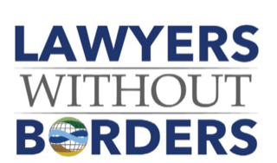
Lawyers Without Borders

Slide 3
Who We Are
Our Mission
Our Objective
BUILD capacity & integrity in justice systems
PROMOTE the rule of law
SERVE the underserved
PROTECT the disadvantaged
PROMOTE human rights
IN ORDER TO
Develop programs that improve access to justice guided by a mandate of neutrality and independence

Slide 4
Our Team
Community Leaders
Supporting Law Firms
LWOB Staff & Board
Harnessing the power of pro bono
Police, Prosecutors, & Judges/ Public Defenders
Student
Divisions
Civil Litigators & Corporate Expertise

Slide 5
Our Projects - Overview
Mediation
Gender Rights
and GBV
Inheritance and
Succession
Family Law
Juvenile Justice
Trainings Legislative
Workshops Community
Outreach
Access To Justice
Skills Development
Combatting Crime
Human trafficking
Wildlife trafficking
Child labor
Forced labor
Counter terrorism
Civil and Political

Slide 6
Our Projects - Results
Kenya, Bolivia, Paraguay, and Thailand Adopted Human Trafficking Standards
SOPS for Law Enforcement in Tanzania
Prosecutors’ Training Institute, a National Resource for 1500 prosecutors in Kenya
Trial Advocacy Training for 2000+ Kenya
Prosecutors and Judges increasing Access to Courts and Fair Trials
Case Digests for Government of
Liberia
1000’s of Students and Interns Contribute Research & Service Directly to Our Mission and Work
Access To Justice
Skills Development
Combatting Crime
5000+ high impact workshops, technical assistance projects, and specialized presentations developed and implemented

Slide 7
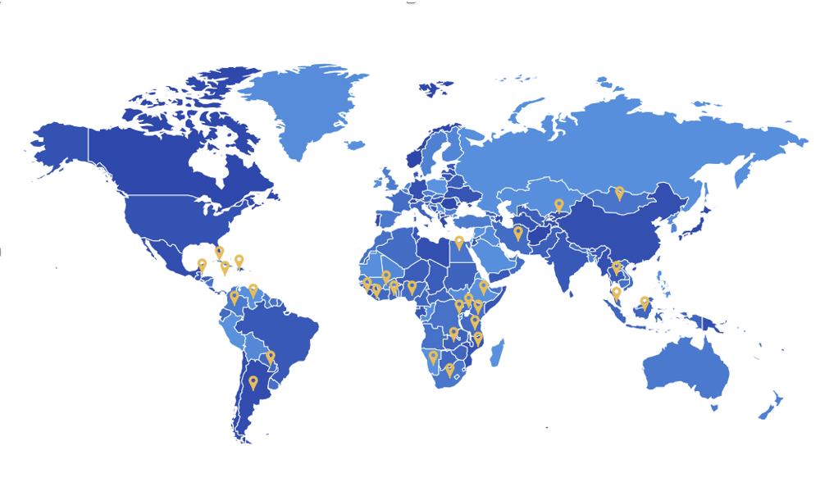
Where We Work

Slide 8
Where We Work - ATLAS
LWOB works with Winrock International and Partners of the Americas to implement the U.S. Department of Labor-funded project ATLAS: Attaining Lasting Change for Better Enforcement of Labor and Criminal Law to Address Child Labor, Forced Labor and Human Trafficking.
ATLAS works towards three interrelated outcomes: strengthened labor and/or criminal legal frameworks concerning child labor, forced labor, and/or human trafficking by helping stakeholders gain the authority to act;
improved enforcement of labor and/or criminal frameworks by strengthening stakeholders’ capacity to act; and
increased coordination among law enforcement and social protection entities, which ensures that stakeholders have the mechanism to be effective.
The LWOB ATLAS team is preparing for enforcement training programs that will take place in Argentina starting in 2021 on child labor, forced labor, and human trafficking.

Slide 9
Where We Work - WICRI
WIldlife CRIme Mock Trial Competition (“WICRI”) is an LWOB-administered project designed to improve prosecutorial capacity in complex wildlife trafficking cases through a series of lawyer mock trial competitions in Kenya and Tanzania.
LWOB uses a variety of educational tools in the trial advocacy trainings, including new PowerPoint presentations that address the more advanced and complex issues encountered when prosecuting wildlife trafficking cases.
Most importantly however, LWOB uses in-person and virtual seminars, proven to produce a higher information retention rate, to teach and discuss with participants.

Slide 10
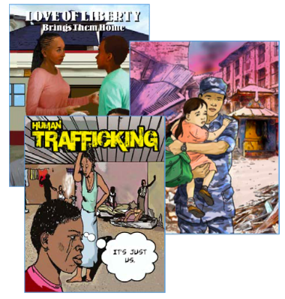
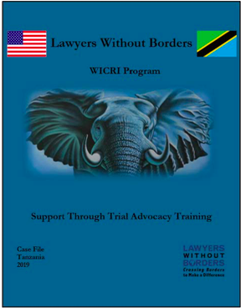
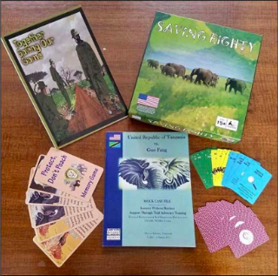
How We Work – Case Files
Graphic Novels
Case Files
Educational
Activities

Slide 11
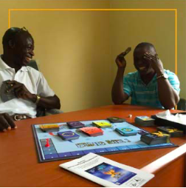
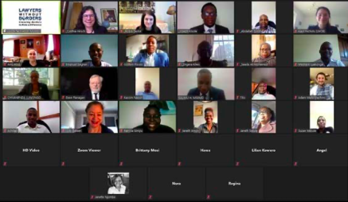
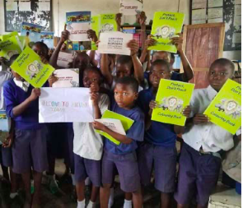
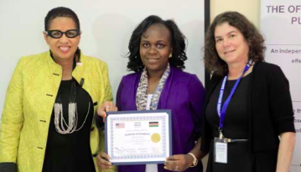
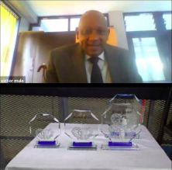
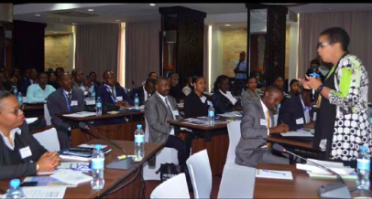
How We Work – Seminars & Training

Slide 12
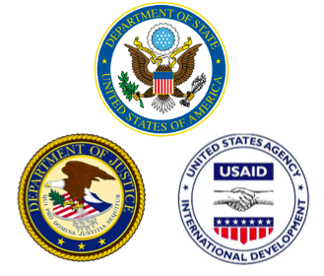
National & International Agencies
Our partners donate 10,000+ hours, worth more than $8 million in the last five years.
US Government Organizations
Foreign and Internation Organisations
Associations

Slide 13
Our Partners – Law Firms & Corporates
Law Firms
Corporations

Slide 14
Student Divisions
30+ active
student divisions spanning 4 continents
Participate in the annual Rule of Law Innovation Contest
US Chapter
Central to LWOB ethos pro bono rule of law work
Conduct key research for LWOB projects

Slide 15
Student Divisions
UK Chapters
Rest of World

Slide 16
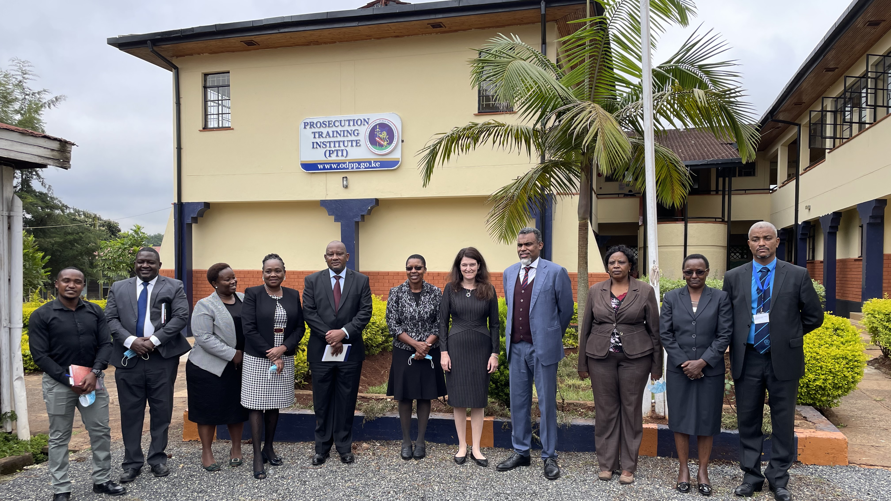

Slide 17
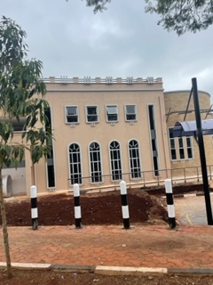

Slide 18
Why We Need Your Support
You can help grow Lawyers Without Borders’ programming to promote the Rule of Law across the globe
Anti-Human Trafficking & Child Friendly Spaces
Human rights and Skills Based Training
Wildlife Crime Roundtables
Harness LWOB & stakeholder expertise and experience to combat global human trafficking efforts
Deploy LWOB’s programmatic expertise for rapid response trainings
Harness LWOB & stakeholder expertise and experience to combat wildlife crime

Slide 19
Contact
ROBIN TAYLOR
rtaylor@lwob.org

