Slide 2
CAFF advocates for family farmers & sustainable agriculture.
Through policy and programs, we’re building a movement that fosters family-scale agriculture that cares for the land, sustains local economies and promotes social justice.
Notes:
play key role in state and national legislation are the voice of the smaller farmer.
Many programs that are ground in need….

Slide 3
Values

Slide 4
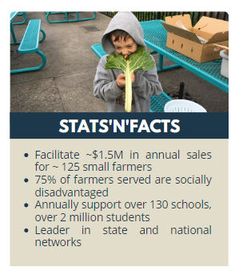
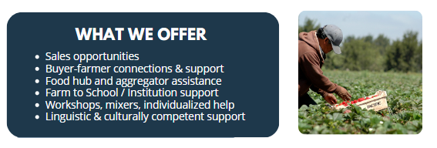
Farm to Market Program
We connect farmers, especially historically underserved farmers, with sales opportunities while simultaneously providing technical assistance, resources, and trainings to ensure that capacity, supply, and demand grow together.
Notes:
Connect farmers with distributors, food hubs, and aggregators for increased sales
Identify, support, and connect buyers interested in purchasing from smaller farmers
Help schools and other institutions develop and implement local procurement programs including bid development and promotions
Build farmer's knowledge and capacity via technical assistance, resources, workshops and individualized troubleshooting
Networking events such as buyer-seller mixers, farm to school events, listening sessions, workshops, and more

Slide 5
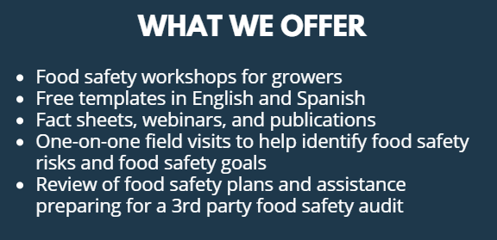
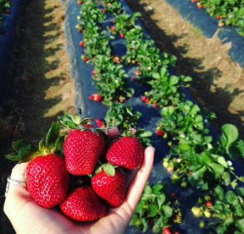
Food Safety Program
We help farmers understand good agricultural practices (GAPs), develop food safety plans specific to their operation, learn about requirements of the Food Safety Modernization Act (FSMA), and prepare for buyer food safety requirements.
Notes:
Farmers Beet podcast 1:1 help, podcasts, trainings. 100s of plans The type of food safety plan and required documentation vary and are based on factors such as:
What are your buyers asking for?
What are the state/federal regulations that apply to your farm?
What are other business-related costs (insurance, etc.)?

Slide 6
Small Farm Technology Hub
Identifying right-fit technologies for the small farm. We help small-scale farmers, food hubs, and farmers markets navigate technological resources and expand market opportunities.
Free consultation services available to small scale farmers, food hubs, and farmers markets operating out of California
Free workshops & webinars
Free resources on our website and social media channels

Slide 7
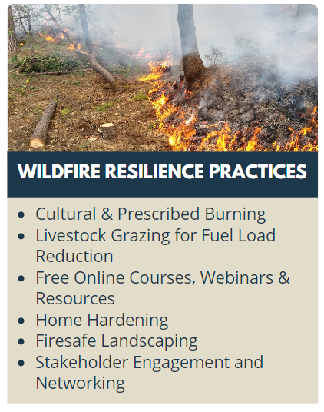
Wildfire Resilience Program
This program offers technical assistance and services that help small farms, ranches, and rural communities best prepare for and recover from wildfire impacts.
Distribute emergency funding and provide technical assistance on external cost-share/incentive programs
Host town hall listening sessions to solicit farmer and community input on recovery and preparedness needs
Provide field days and demonstrations for hands-on experience
Facilitate a leadership council to guide efficient and equitable program delivery
Notes:
~$2M since 2020. As California’s climate changes, agricultural operators across the state increasingly find themselves facing unprecedented droughts, wildfires, floods and erratic weather.

Slide 8
Ecological Farming Program
Our projects bring together science and farmer experience through on-farm research and demonstration to build better understanding around ecological farming best practices
We facilitate farmer-to-farmer learning opportunities that focus on knowledge sharing among farmers and technical assistance providers
We connect farmers to resources and provide technical assistance to farmers interested in implementing ecological farming practices

Slide 9
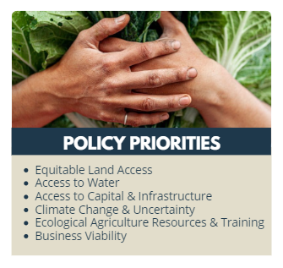
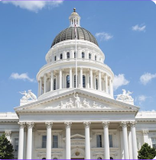
Policy Program
We are the voice of family-scale agriculture in California. We work to give voice to family farmers, listening to their needs, concerns and aspirations, and speaking up for those often too busy in the field growing our food to do so on their own.
We work along alongside farmers, Legislators, and agency officials to craft new policies or direct funding that center family farmers.
Notes:
We are the voice of the farmer. We want to hear from you. Our policy priorities are…Captured through listening

Slide 10
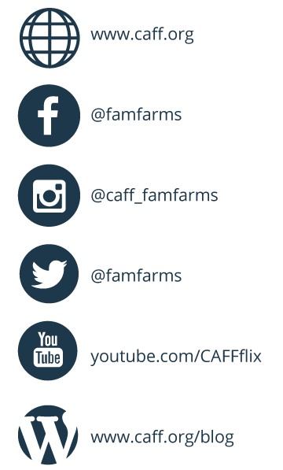
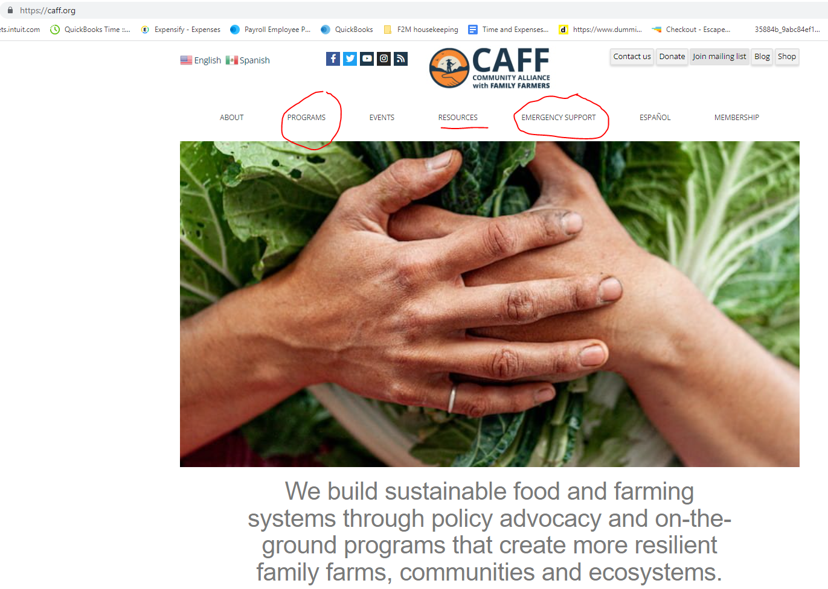

Slide 11
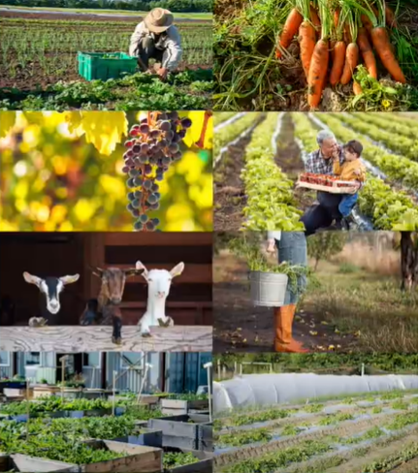
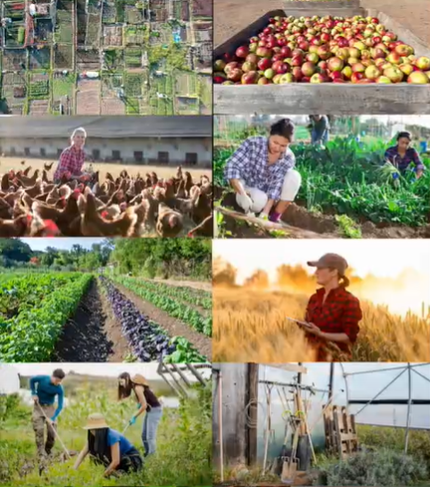
Contact us:
yousef@caff.org
info@caff.org

