Slide 1
Estate Planning Misconceptions
LAUREN C. JONES LAW
916-226-4470
info@laurencjoneslaw.com
Notes:
LAUREN – INTRO ABOUT Presentation packets

Slide 2
Who Is Lauren C. Jones Law?
We merge our experience, skill, and education in the legal community to provide specialized services to our clients in Estate Planning and Business Law.
Our driving philosophy at Lauren C. Jones Law is integrity; to be genuine as individuals and as a firm. It is that authenticity that keeps clients coming back. The clients know that, even if it’s not what they want to hear, the high-quality professional services they receive will come from an honest opinion that they can trust.

Slide 3
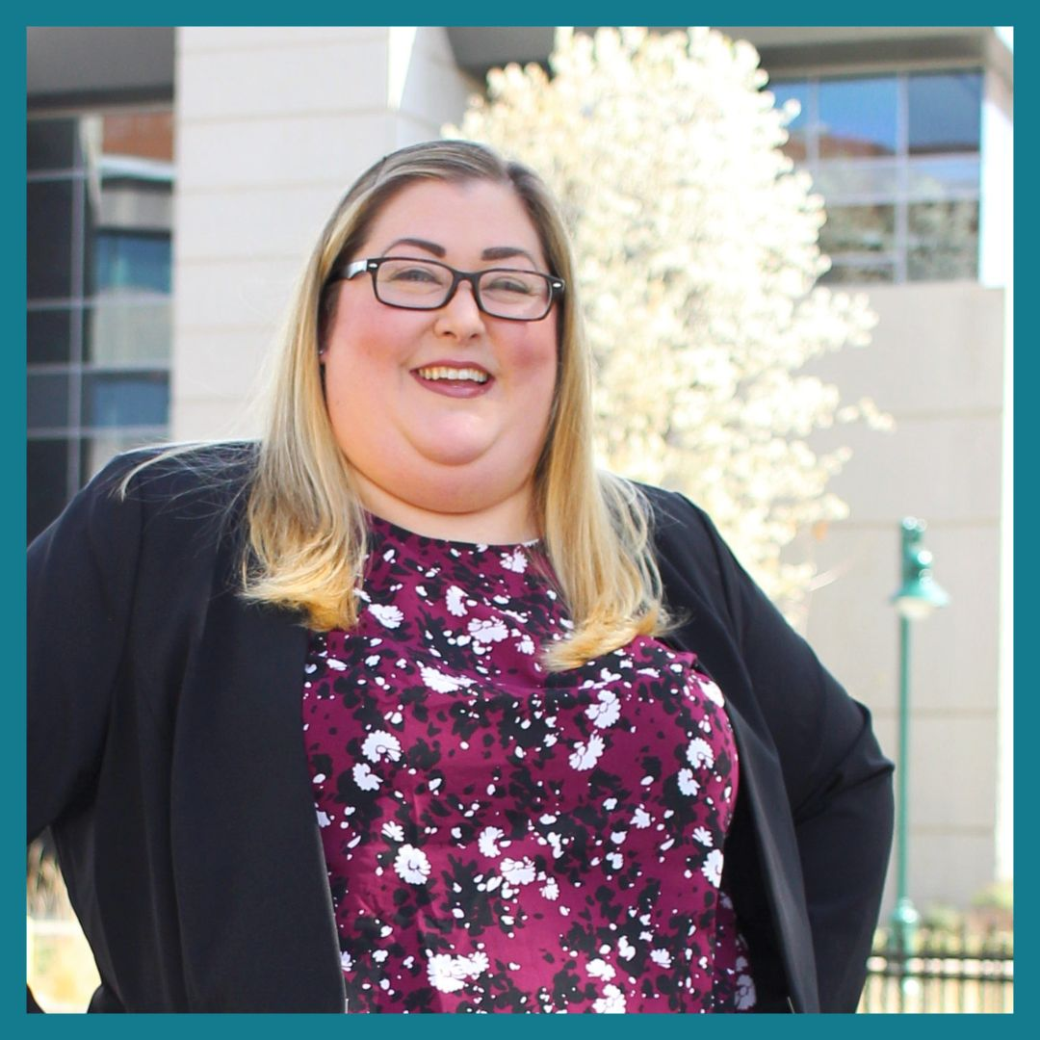
Meet Lauren Jones
Attorney since December 2013.
Graduated from Lincoln Law School of Sacramento in 2013. Ranked number 15 in class and received the award for best Trial Advocacy Team.
Experience in the areas of workers' compensation and civil litigation/subrogation.
Practice Focus is in Business Law, Business Governance, Contracts, Estate Planning, Probate, and Estate Administration.
President of Women Lawyers of Sacramento.
Past President of Soroptimist of Woodland.
2018-2023 Super Lawyers Rising Star
2019 Sac Business Journal Best of the Bar
2020 Sac Business Journal 40 under 40
2021 Sacramento Magazine Top Lawyers in Sacramento
2021 and 2022 Daily Democrat’s Best Law Firm in Yolo County
Enjoys painting, photography and spending time with her husband, daughter, family and friends.

Slide 4
Common Misconceptions About Estate Planning True/False?
Notes:
How many think that estate planning is just for the rich and famous? Something that you need only if you have a lot of money?
Estate planning is for everyone.
There are several benefits to estate planning for individuals and families on all income levels.

Slide 5
Common Misconceptions About Estate Planning True/False?
You need to own a home to have an estate plan
Answer: False
Estate Planning deals with more than a home.
The value of your assets alone may push you into probate.
$184,500 asset value
$61,500 real property value
Without any estate planning you are not protected during incapacity.
Notes:
How many think that estate planning is just for the rich and famous? Something that you need only if you have a lot of money?
Estate planning is for everyone.
There are several benefits to estate planning for individuals and families on all income levels.

Slide 6
Common Misconceptions About Estate Planning True/False?
You only need a will
Answer: Maybe, but not likely
It depends on your goals.
You cannot avoid probate with a will alone.
A will does not handle incapacity.
Notes:
How many think that estate planning is just for the rich and famous? Something that you need only if you have a lot of money?
Estate planning is for everyone.
There are several benefits to estate planning for individuals and families on all income levels.

Slide 7
Common Misconceptions About Estate Planning True/False?
Age should help you decide when to do estate planning
Answer: True, when you turn 18
Once you turn 18 years old no one is legally in charge of you or your assets.
If you are incapacitated without estate planning documents, you have not designated anyone to make decisions for you or handle your affairs.
Notes:
How many think that estate planning is just for the rich and famous? Something that you need only if you have a lot of money?
Estate planning is for everyone.
There are several benefits to estate planning for individuals and families on all income levels.

Slide 8
Common Misconceptions About Estate Planning True/False?
You should add your children to your deed when you are alive?
Answer: False!!!!
Adding your children to your deed during your lifetime results in several tax consequences.
Your children will lose their stepped-up basis.
There will be a reassessment in property taxes.
Liability: the actions of your children can put your assets at risk.
Notes:
How many think that estate planning is just for the rich and famous? Something that you need only if you have a lot of money?
Estate planning is for everyone.
There are several benefits to estate planning for individuals and families on all income levels.

Slide 9
Common Misconceptions About Estate Planning True/False?
Estate planning is for the rich and famous
Answer: False
Everyone needs some form of estate planning, if that means a revocable living trust with all ancillary documents, or just a health care directive.
Notes:
How many think that estate planning is just for the rich and famous? Something that you need only if you have a lot of money?
Estate planning is for everyone.
There are several benefits to estate planning for individuals and families on all income levels.

Slide 10
Big Differences
between will and revocable living trust

Slide 11
Will
Revocable Living Trust
Transfers Assets upon death to who you choose
Transfers Assets upon death to who you choose

Slide 12
Will
Revocable Living Trust
Transfers Assets upon death to who you choose
Transfers Assets upon death to who you choose
But…
also allows management of asset while living

Slide 13
Will
Revocable Living Trust
Still required to go through probate
Avoids Probate

Slide 14
Current Probate Attorney’s Fees:
4% of the first $100,000 of the gross value of the probate estate
3% of the next $100,000
2% of the next $800,000
1% of the next $9 million
.5% of the next $15 million
A reasonable amount (determined by the court) for any amounts higher than $25 million.
*This doesn’t include Court costs and fees to the administrator.
Notes:
$400,000 home totals $11,000

Slide 15
Probate Takes Time
It takes a least a month from filing your Petition to get appointed as Administrator to be able manage accounts and/or assets. In some counties right now, it takes 6 months.
Average time for probate to finish and assets to be disbursed is 8 months – a year. In some counties, it takes a year - 3 years.

Slide 16
Will
Revocable Living Trust
Does not handle assets when you are incapacitated
Handles assets when you are incapacitated

Slide 17
What Else Can A Revocable Living Trust Do?
Allow assets to be held and disbursed over ages, time periods, or upon specific events.
Based upon your provisions, Trustee can create new trusts to hold and administer assets after your death.
Assets held in trust after death can continue to grow.
Can protect beneficiaries from themselves or creditors.

Slide 18
We Can Help!
FULL TRUST PACKAGES which include INCAPACITY PACKAGES
OR
INCAPACITY PACKAGES ALONE
Free Consult
Fee Ranges

Slide 19
Questions?
LAUREN C. JONES LAW
916-226-4470
info@laurencjoneslaw.com

