Slide 1
Woodland Rotary Endowment
Community
A Pillar of Service

Slide 2
Understanding of Organization
Woodland Rotary Endowment
IRC 501(c)(3) - Charitable Organization
Contributions = ARE TAX DEDUCTIBLE
Governed by Board of Directors – Partially Elected by Membership of the Rotary Club of Woodland
Independently formed
Membership in Rotary Club of Woodland = Membership in Woodland Rotary Endowment
Two-Fold Charter
Scholarships
Charitable

Slide 3
Current Governing Board and Officers
WOODLAND ROTARY ENDOWMENT
Chair Tabb Randolph
Director (Club Treasurer) Tom Schwarzgruber
Director (term ending 6/30/23) Bob Nakken (Endowment Secretary)
Director (term ending 6/30/23) Yvette Roy
Director (term ending 6/30/23) Carl Rodegerdts
Director (term ending 6/30/23) Tabb Randolph
Director (term ending 6/30/24) Dan Stroski
Director (term ending 6/30/24) Nick Roncoroni
Director (term ending 6/30/24) Clyde Brooker
Director (term ending 6/30/24) Lisa Martinez Dunham

Slide 4
Procedural Operations
Woodland Rotary Endowment
Revenue
Donations
Auction
Bequest
Fund Balances
Permanent Scholarship Fund
Permanent Dorris Ag Scholarship Fund
Temporary Berretoni Scholarship Fund
Temporary Designated Funds
Community Fund
Distributions
Scholarship – Two Schools / 4 Years = 8 active
Dorris Ag Scholarship = Single annual scholarship identified and recommended by the Dorris Family
Berrettoni Scholarship Fund = Needs based scholarship
Designated Funds held and operated for approved charitable purposes

Slide 5
Specific Funds
Scholarships
Operations
Formed to Endow Scholarship.
Scholarships for graduating seniors from the Woodland Joint Unified School District (Woodland & Pioneer High Schools)
Criteria = Academic Excellence = Valedictorian
Award = $6,000 disbursed (generally) over a four-year period in increments based upon academic program followed i.e. Semester or Quarter system.
Required reporting of student regarding achievement and current enrollment.
Current Position and Target
The Target was to build the scholarship endowment to a point at which it’s own earning will sustain the scholarship disbursements and maintain inflationary growth
Scholarship Distributions = $12,000, given a 2.5% distribution rate the fund will require $480,000 to reach the target
Current balance is approximately $550,000+/- in the scholarship endowment’s investment account

Slide 6
Scholarship
Additional Notes
Dorris Ag Scholarship
Separate Investment Account
Operated under its own directives
Ongoing funding by the Dorris family with intent for self sustainment
Donnel Fisher Estate
Designated a scholarship
Designated Woodland Rotary Endowment
Court authorized distribution of funds to Endowment for the operations of scholarship
Amount Received approximately $180,000 in 2011.
George M Berrettoni Scholarship
1. Needs based scholarship

Slide 7
Specific Funds
Community Fund
The Community fund is the Woodland Rotary Endowment’s Operating Fund
This fund is unrestricted and is available to fund local, regional and international projects as long as the projects are conducted by 501(c)(3) Charitable Organizations
Major source of funds = Annual Auction.
The auction is operated by the membership on behalf of and in the name of the Woodland Rotary Endowment.
This allows for sponsors, contributors, etc. to make tax deductible charitable donations.
Funds in the past have been utilized to pay current scholarship disbursements as the scholarship investment fund was building to a sustainable level.
Balance of the auction revenues along with general donations to the endowment are utilized for community and international projects.

Slide 8
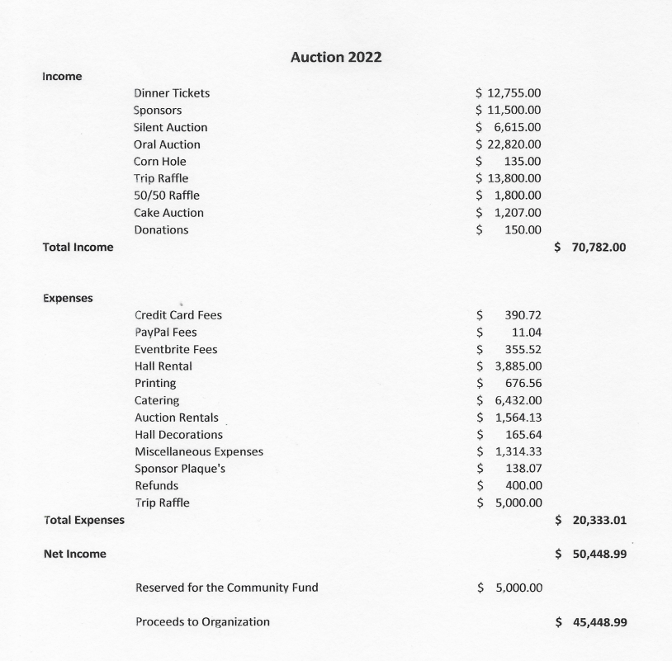

Slide 9
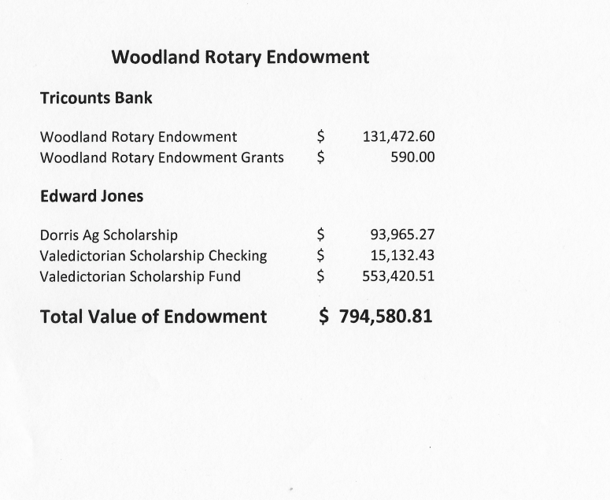

Slide 10
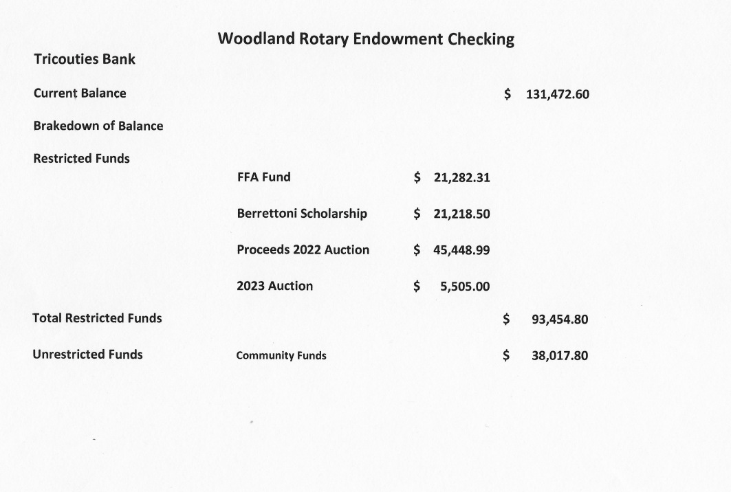

Slide 11
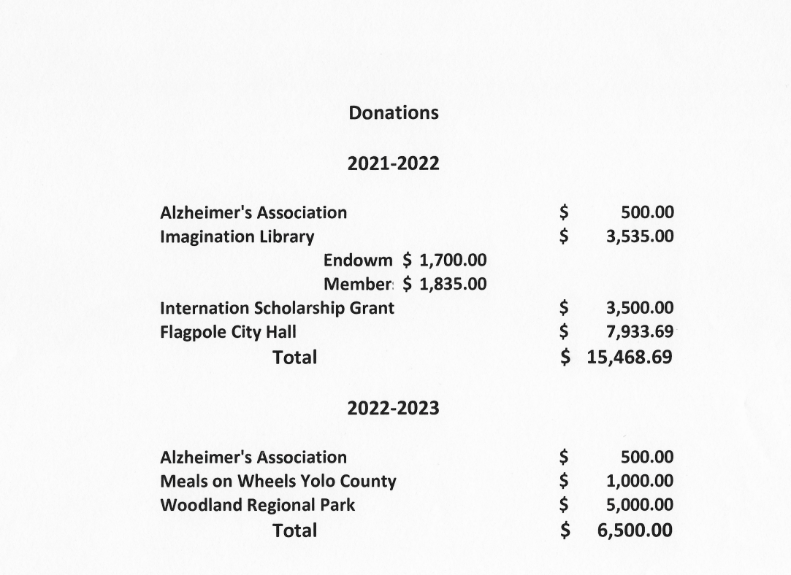

Slide 12
QUESTIONS

