Slide 1
East Beamer Way Campus

Slide 2
Friends of the Mission
Non-Profit Public Benefit Corporation in 1999
Formed in 1997 to support activities of Fourth & Hope
Focus includes emergency, transitaionl, supportive and permanent housing projects
Lead Fourth & Hope’s capital development efforts including existing Walter’s House, Emergency Shelter, East Oak 4-plexes
In Woodland: own 925 North Street apartments (Used by Fourth & Hope) & Vacant Land at Kentucky & Freeman Sts.
In West Sacramento: own 5 Permanent Supportive
Housing Units

Slide 3
Board Members
Edward Shelley, President – Corner Drug
Elizabeth Eaton - Retired Attorney
Lorene Leathers – Nursing Professional
Janet Ruggiero – Retired Planner
Tom Eaton – Owner, Eaton Oil Drilling
Executive Director: Scott Thurmond, Thurmond Consulting

Slide 4
East Beamer Team
City of Woodland
Friends of the Mission
Fourth & Hope
Woodland Opportunity Village
Yolo County
Yolo County Housing Authority

Slide 5
History of Project
Discussion began in 2018
Finding Land was first hurdle
Work with City to use their property on East Beamer Street-located in the County
Funding – next hurdle. Different sources necessary
Priority of building new emergency shelter (1st phase)
Costs increase due to infrastructure and building costs – Switch funding
from NPLH to Project HomeKey

Slide 6
Funders of Project
City of Woodland
County of Yolo
Partnership Health Plan
State of California
Dignity Health
Sutter Health Foundation

Slide 7
Emergency Shelter

Slide 8
Quick Facts
100 Bed Shelter
Operational since December 2020
Approximately $4.8 million to construct
60 men and 40 women
Daytime Support Services and Night Meal
Notes:
City funds
County funds
Sutter Foundation Funds
Dignity Health

Slide 9
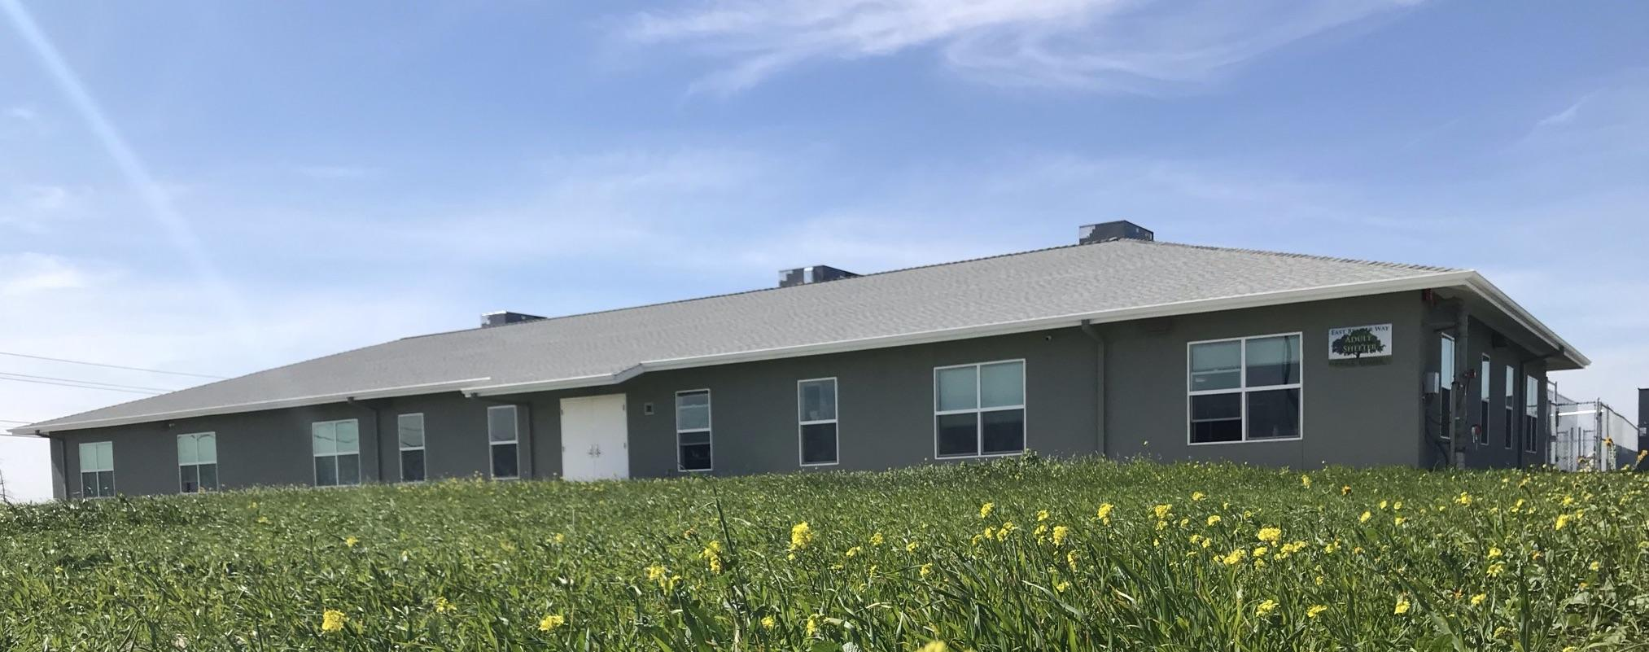
Notes:
City funds
County funds
Sutter Foundation Funds
Dignity Health

Slide 10
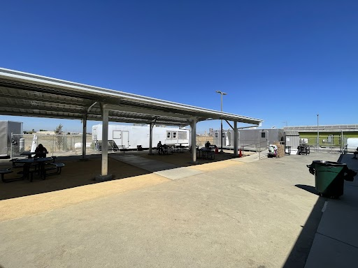
Notes:
City funds
County funds
Sutter Foundation Funds
Dignity Health

Slide 11
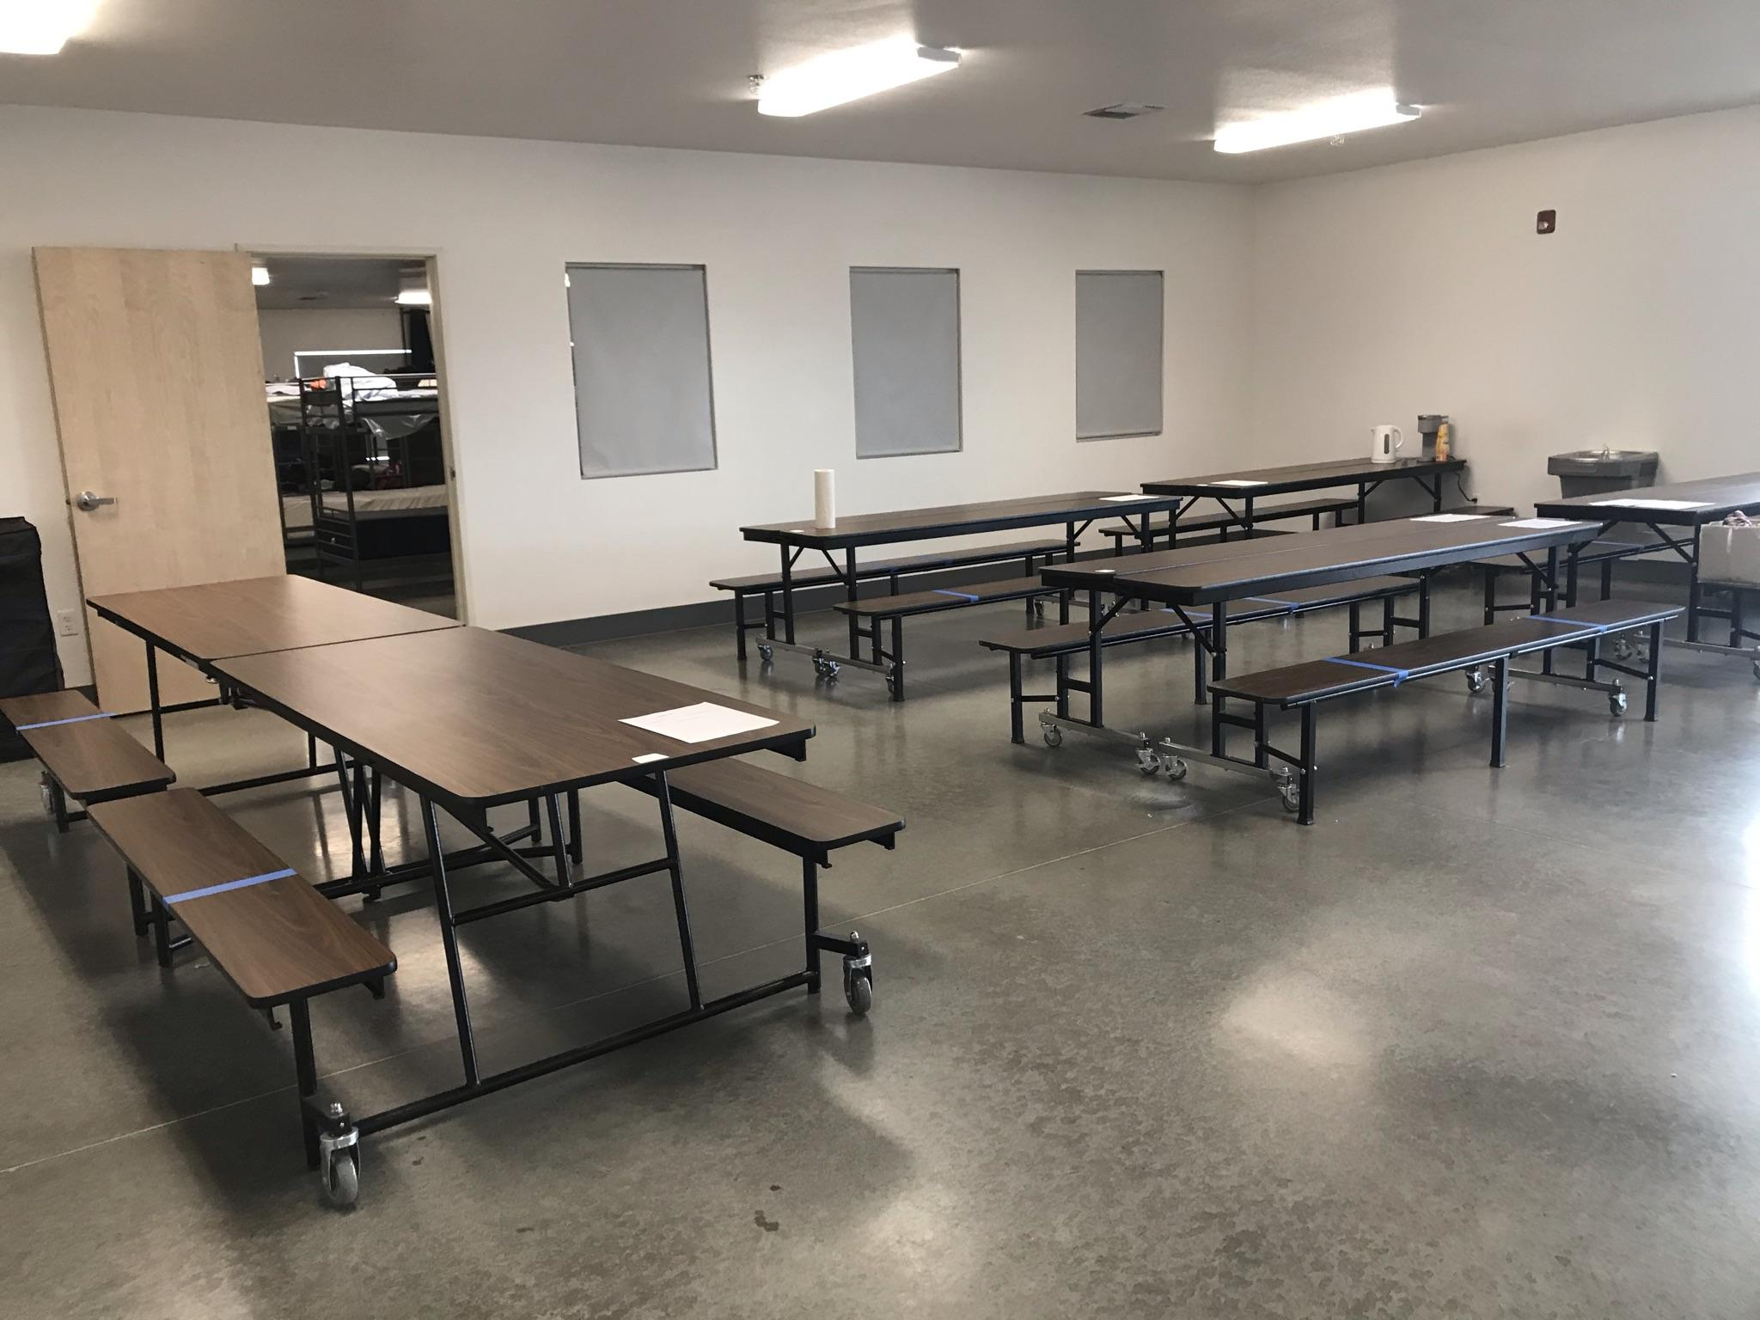
Notes:
City funds
County funds
Sutter Foundation Funds
Dignity Health

Slide 12
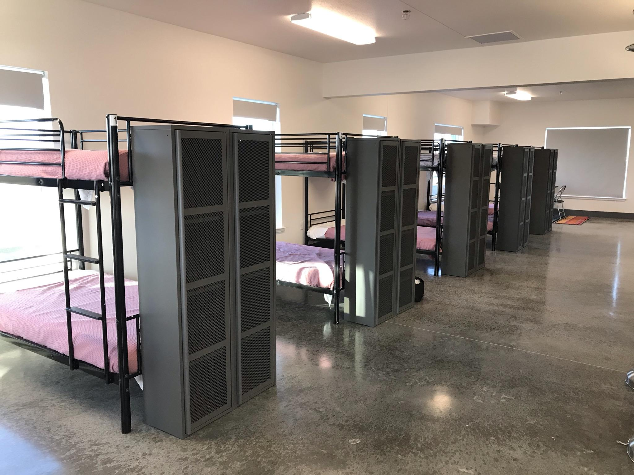
Notes:
City funds
County funds
Sutter Foundation Funds
Dignity Health

Slide 13
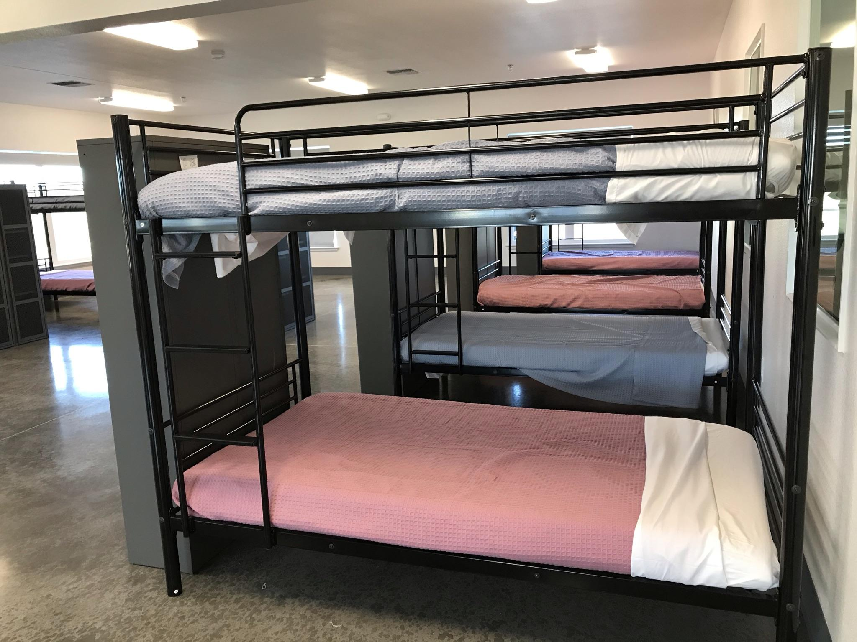
Notes:
City funds
County funds
Sutter Foundation Funds
Dignity Health

Slide 14
Future Shelter Addition
Provisions for
permanent restrooms,
showers,
kitchen,
laundry area
Offices for treatment and service needs of shelter residents
Separate rooms for residents of shelter who need health care and separation from shelter resident(e.g. COVID)

Slide 15
Permanent Supportive Housing Project
Notes:
Funding still needed for this building

Slide 16
Quick Facts
60 Units of Affordable Housing
Operational since October 2022
Approximately $16 million to construct
Modular Construction: Cutting Edge in Woodland
Residential Services and Case Management for all tenants
Affordable Rent: Average $600/mo(Utilities Inc)
Notes:
Residents eligible for vouchers to assist with their rents.
Social workers working each day/ 29 units –Fourth & Hope
31 units – Hope Cooperative
Vouchers – 3 year goal on every unit
Units provided furniture, bathroom basket by WEM, kitchen and bedroom baskets by several Woodland donors, dishes from Holy Rosary Church

Slide 17
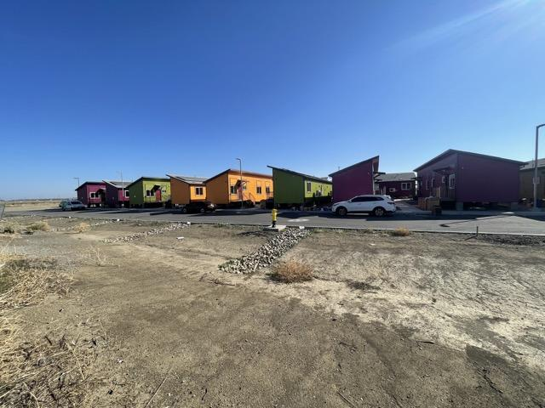

Slide 18
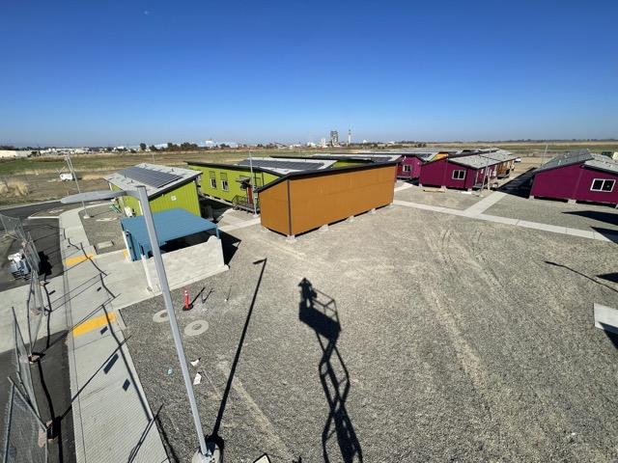

Slide 19
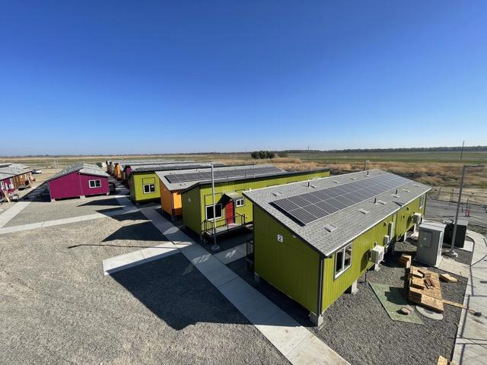

Slide 20
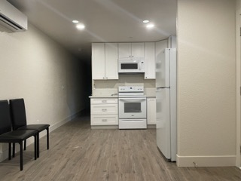

Slide 21
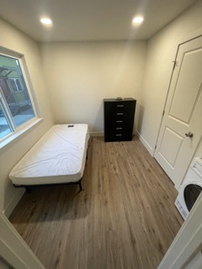
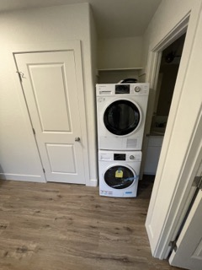

Slide 22
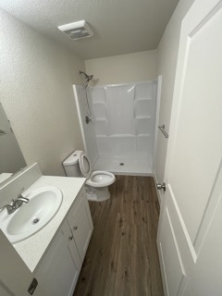
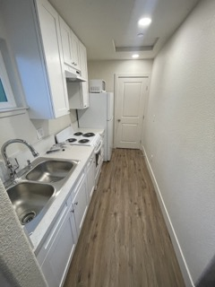

Slide 23
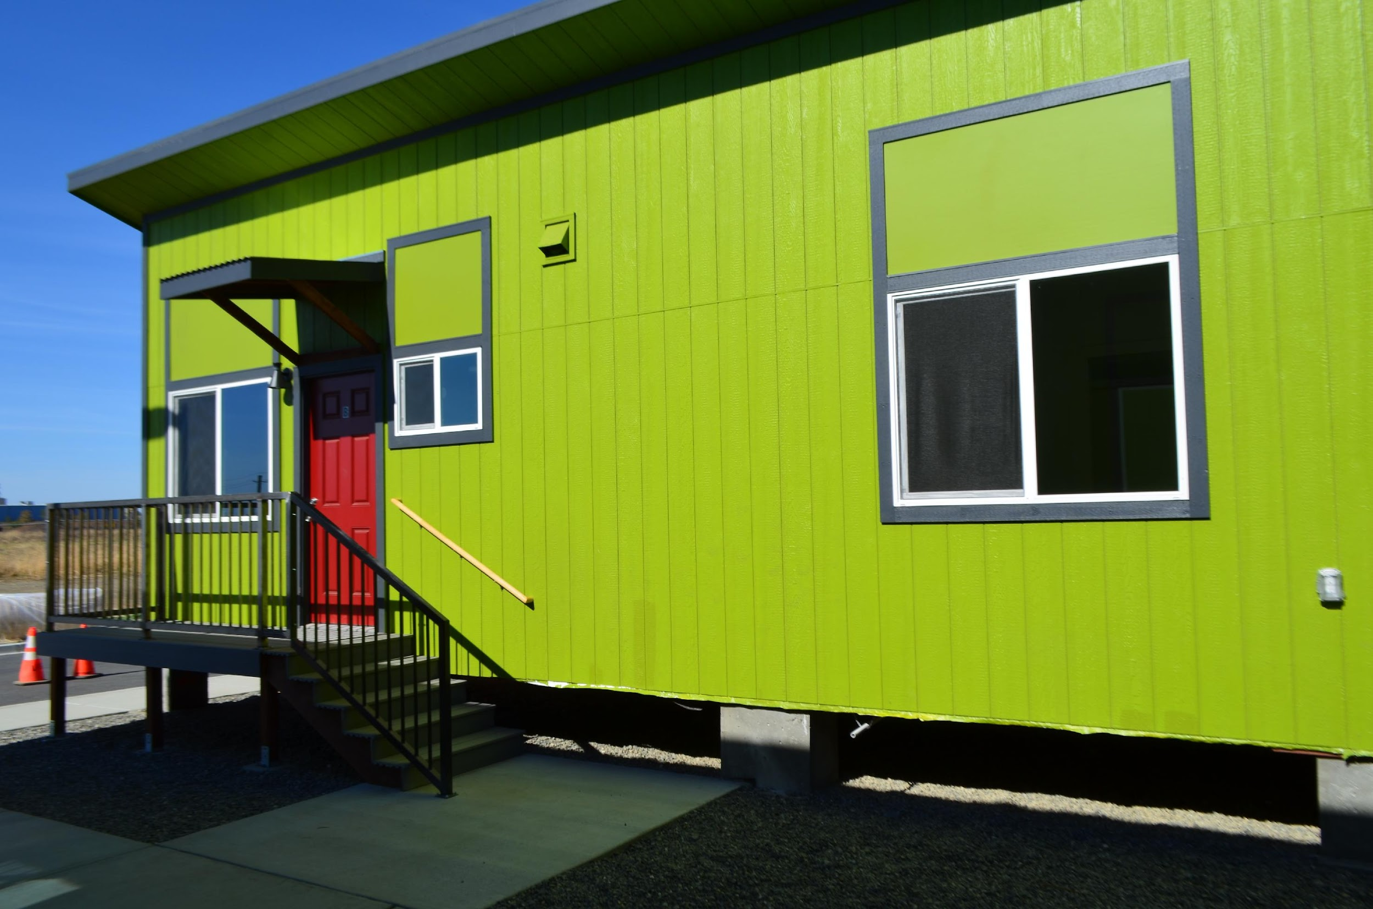

Slide 24
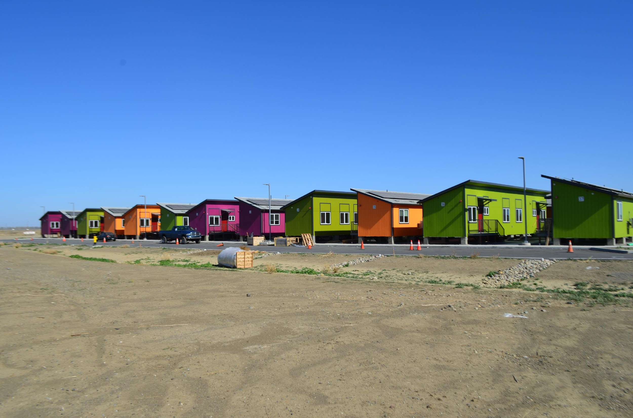

Slide 25
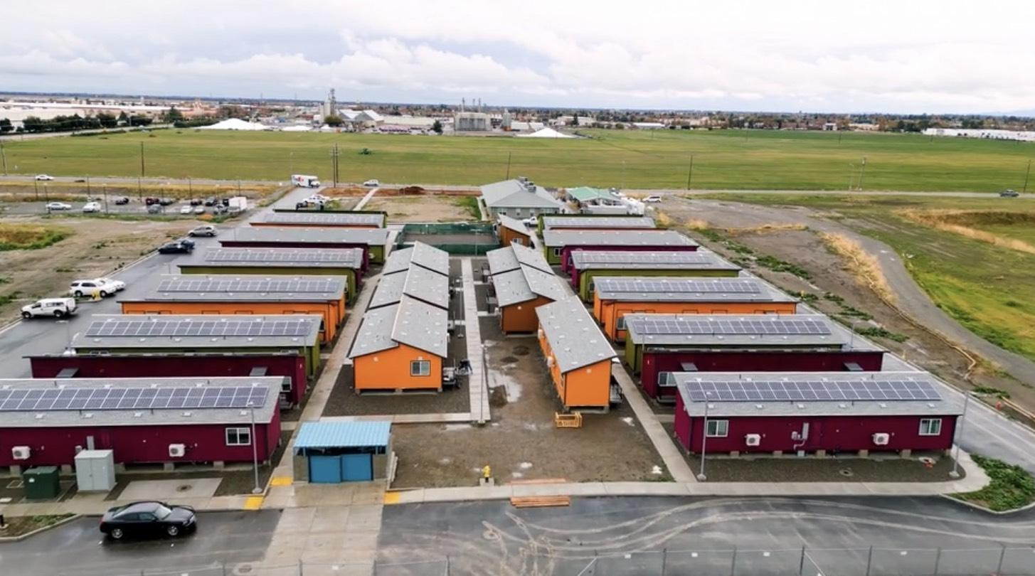

Slide 26
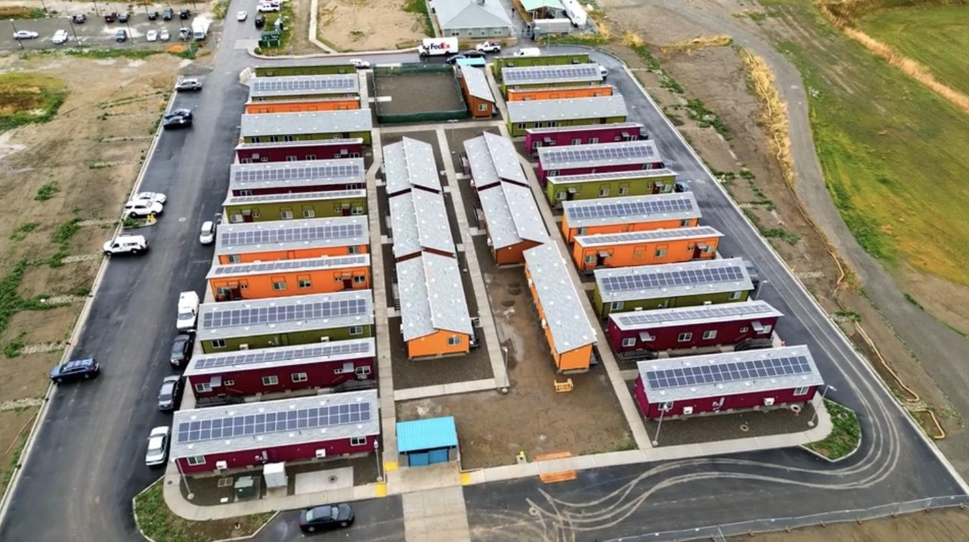

Slide 27
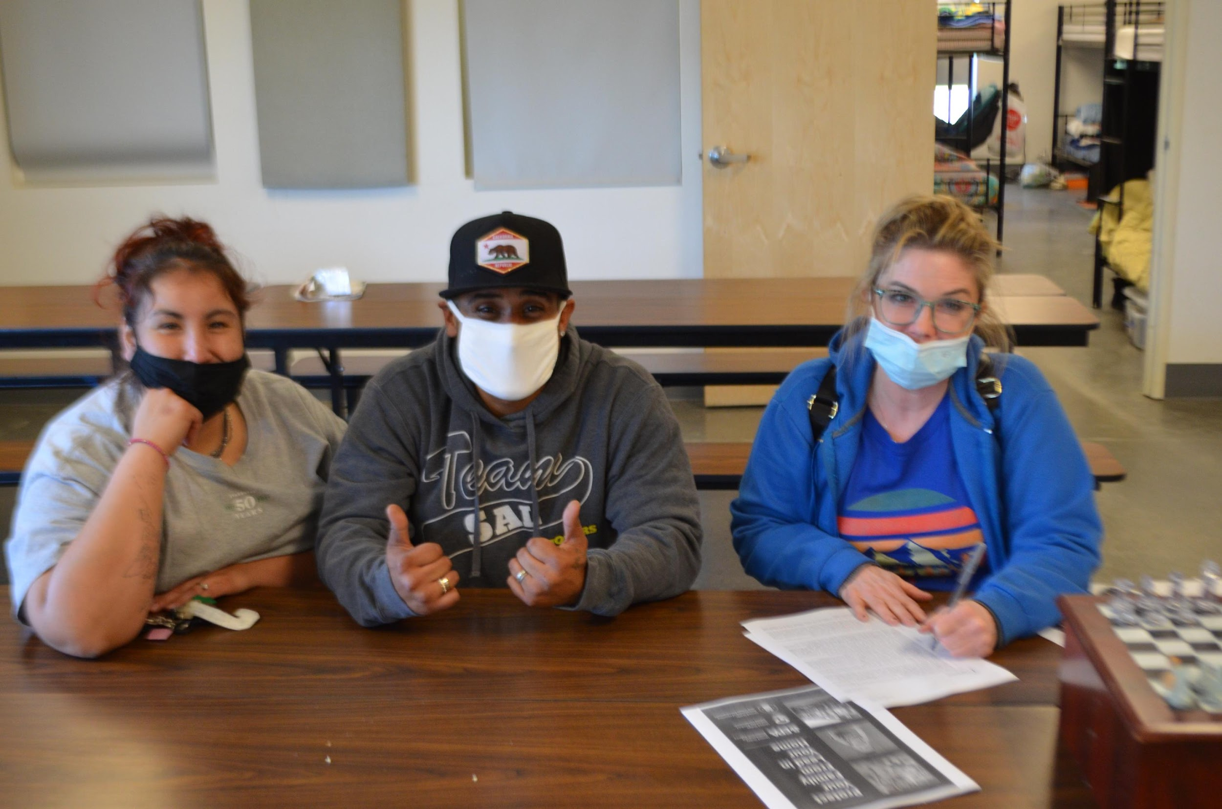
Signing my Lease

Slide 28
Treatment Facility

Slide 29
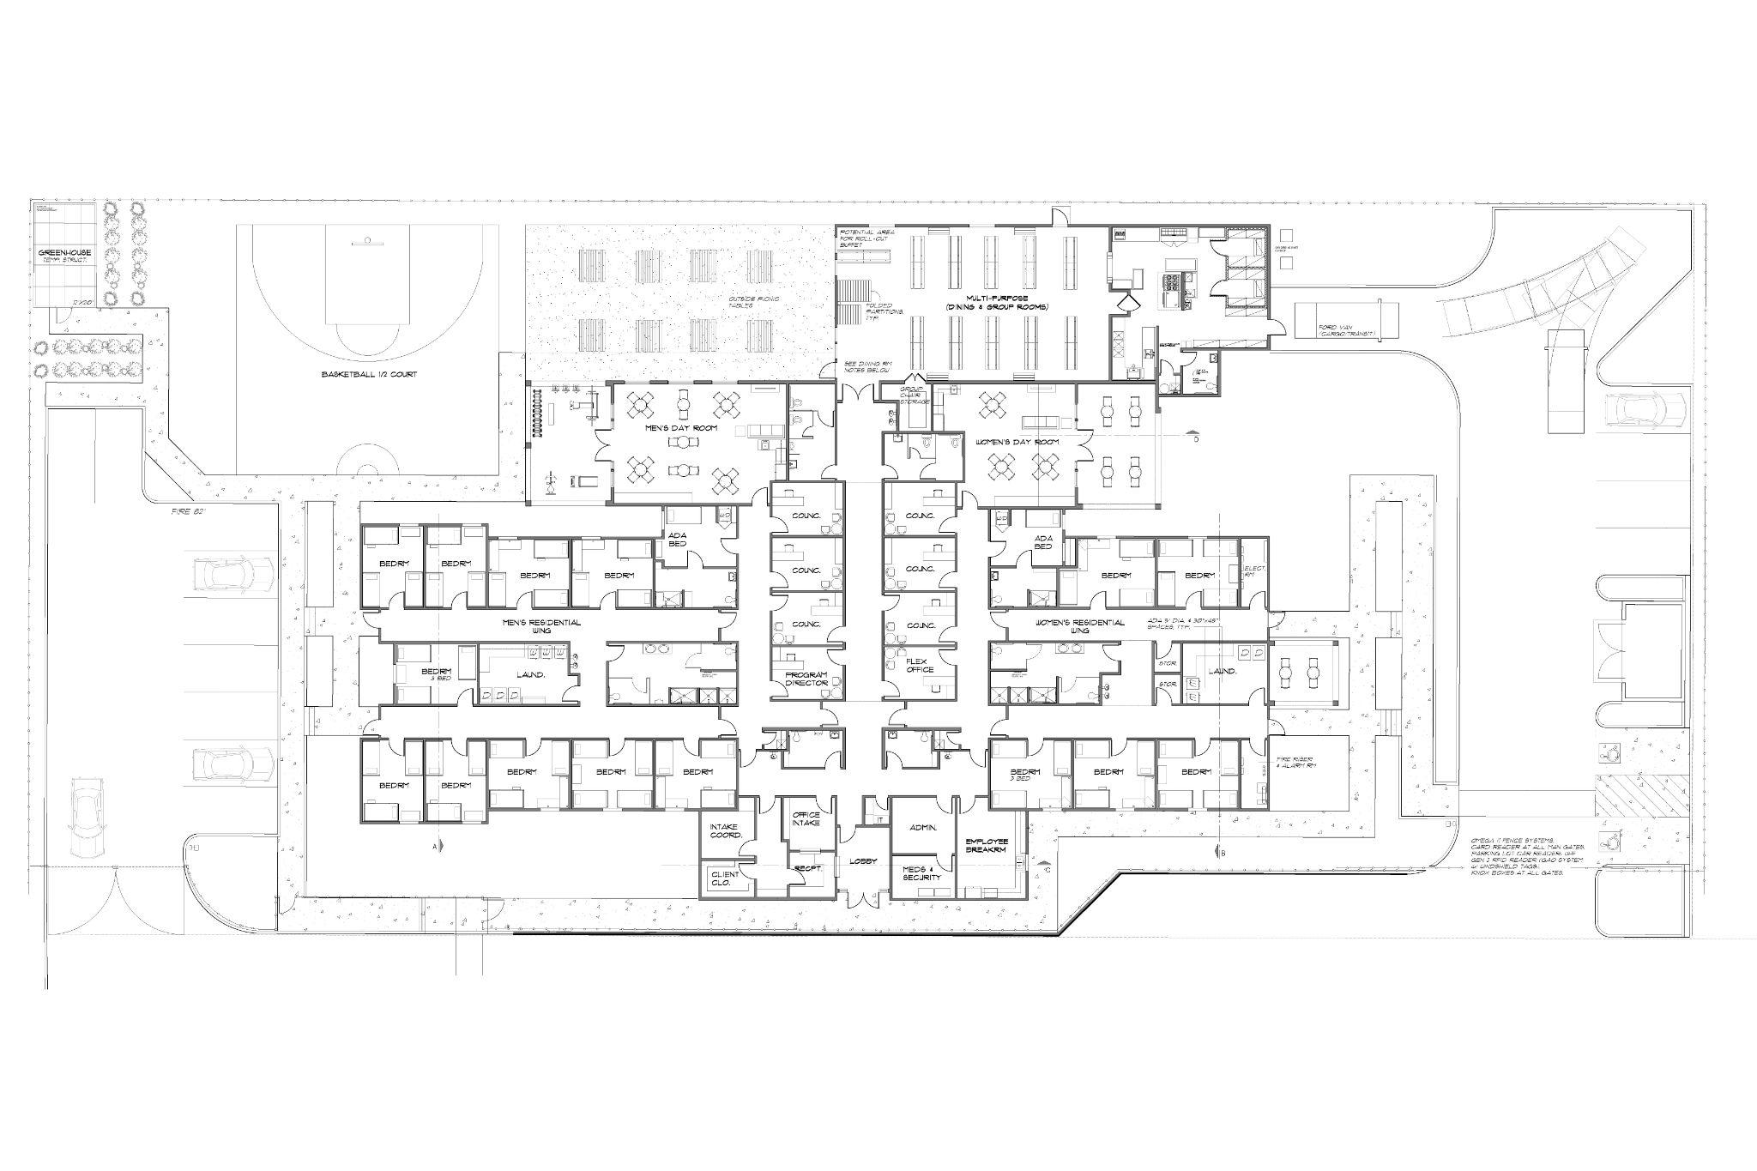

Slide 30
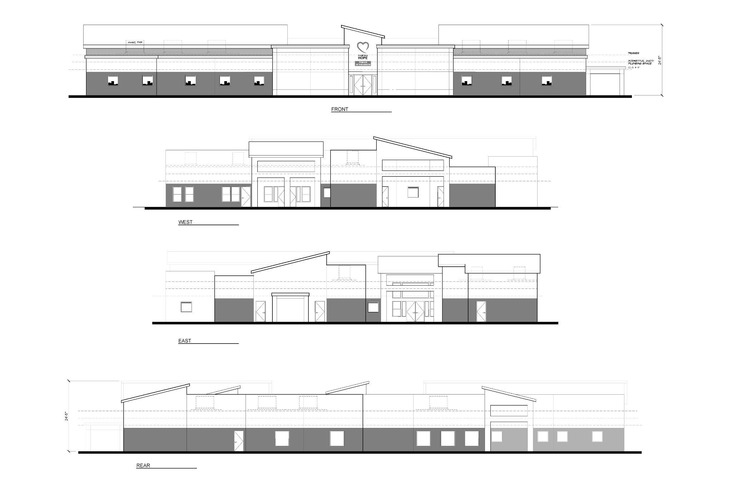

Slide 31
Quick Facts
60 Bed Alcohol and Drug Treatment
Completion Date: Fall of 2023
Approximately $14 million to construct
Intense treatment services at no cost to program participants
BHCIP Grant
Notes:
Behavioral Health Continuum Infrastructure Program through State Dept of Health Services
Break ground December 2nd
Broward Construction

