Slide 1
Lower Cache Creek Flood Risk Reduction Project
Presentation to the Woodland Rotary Club
February 27, 2024

Slide 2
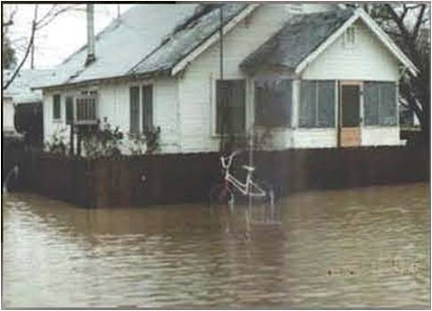
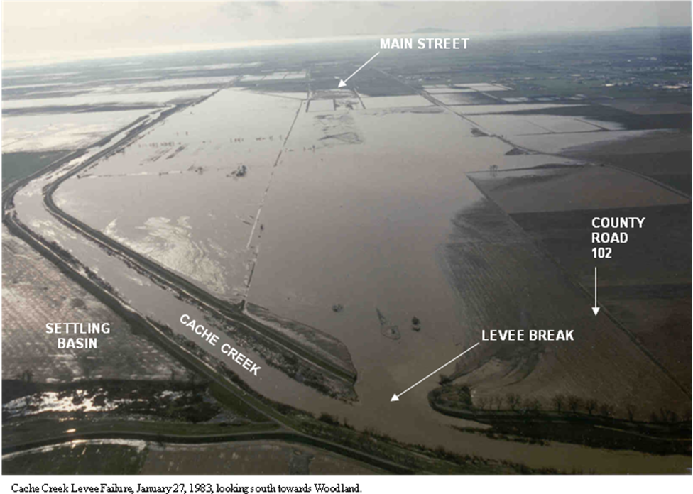
Historical Flooding
Woodland 1983
1940 – overbank flooding
1955 – overtopped levees
1958 – overtopped levees
Jan 1983 – flood of record
levee breach
flooded what is now Woodland’s industrial area
1995 – overtopped levees
1997 – overtopped levees
1940 inundation
Levee Break, 1983
Notes:
20 severe floods have occurred in basin since 1900. The most severe floods of recent years listed.
In 1983 overland flow flooded areas in the easterly part of what is now in the city limits of Woodland – estimated at 53,000 cfs (1/50). There was a levee break downstream from County Road 102. Federal, state, and local agencies patched levee boils at that time to prevent additional levee breaks along both sides of the levee system.
In 1995 Cache Creek came within 1 block of city.
Several near misses where damage and flood fighting required:
1998 flood fighting and levee boils video
2006, water within 6 inches of overtopping, many homes evacuated, emergency declaration from Gov, extensive levee repair under PL 84-99 program, sig repairs to some roadways

Slide 3
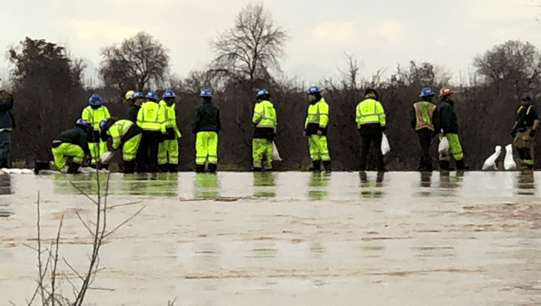
Cache Creek - February 27, 2019
Notes:
20 severe floods have occurred in basin since 1900. The most severe floods of recent years listed.
In 1983 overland flow flooded areas in the easterly part of what is now in the city limits of Woodland – estimated at 53,000 cfs (1/50). There was a levee break downstream from County Road 102. Federal, state, and local agencies patched levee boils at that time to prevent additional levee breaks along both sides of the levee system.
In 1995 Cache Creek came within 1 block of city.
Several near misses where damage and flood fighting required:
1998 flood fighting and levee boils video
2006, water within 6 inches of overtopping, many homes evacuated, emergency declaration from Gov, extensive levee repair under PL 84-99 program, sig repairs to some roadways

Slide 4
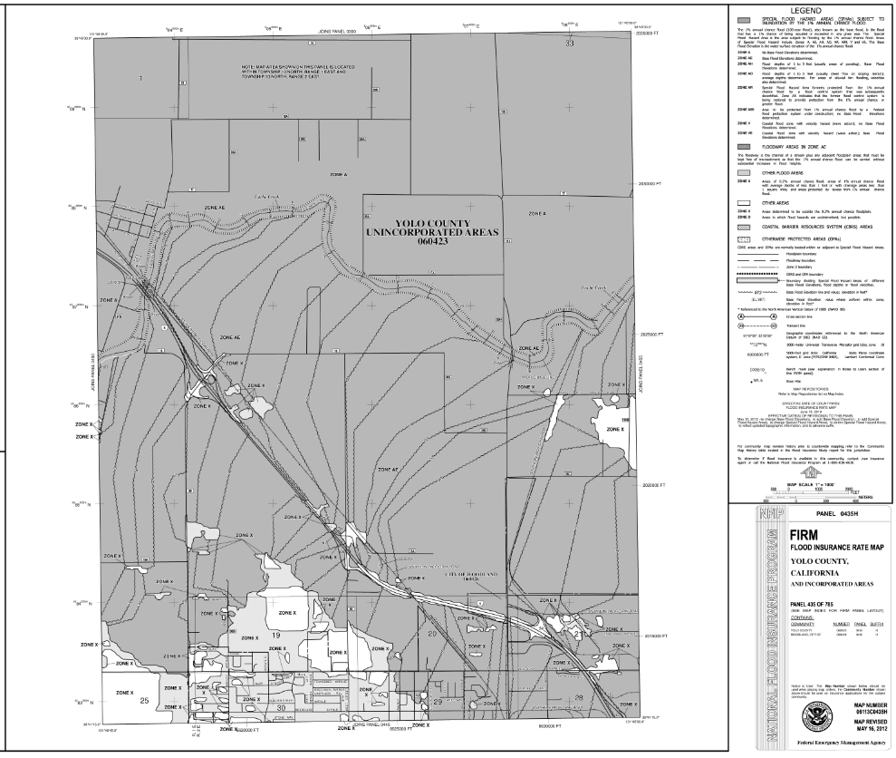
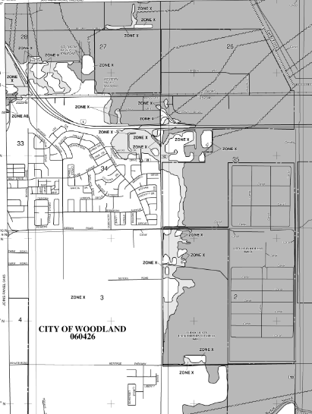
Cache Creek FEMA Flood Maps

Slide 5
USACE Problem Statement for Flood Risk in Woodland
“High flood risk threatens public safety and damages property and critical infrastructure with significant consequences. Flooding is principally caused by runoff of high-intensity rainstorms during winter and spring. Existing levees built assuming Wilson Valley Reservoir and Dam would be constructed upstream to capture high flows. Reservoir and dam were never built, and consequently existing levees overtop between 1/10 and 1/30 annual exceedance probability (AEP) event. Flood threat is exacerbated by raised bed of Interstate 5, which diverts flood flows into the City of Woodland. “

Slide 6
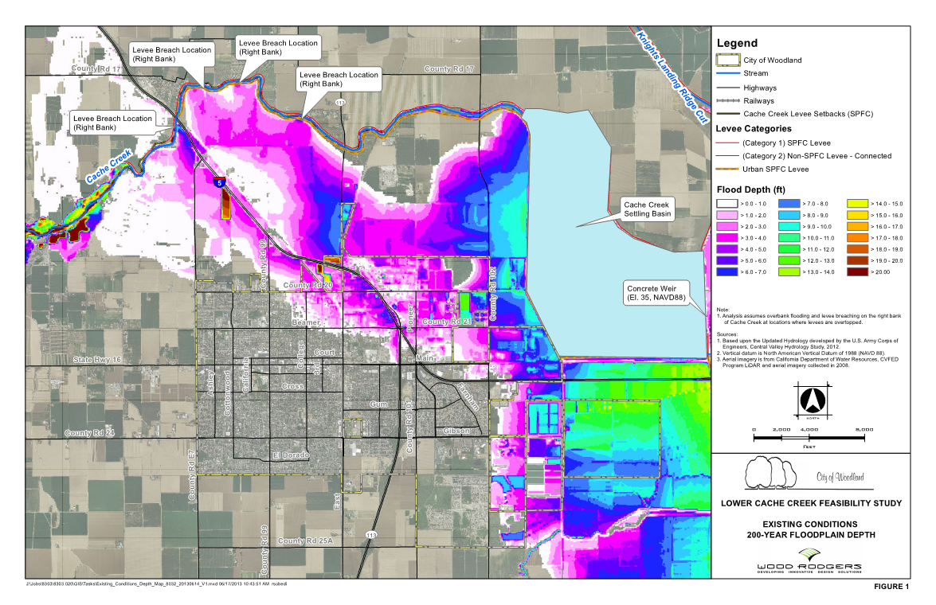

Slide 8
Planning Process
Studied 26 alternatives
USACE only determined a Federal interest in the proposed project
Proposed project is least growth inducing of alternatives evaluated
Alternative that raised and strengthened existing Cache Creek levees in place is $139 million more than the proposed project. City would have had to fund this entirely at local expense.
Project was authorized for construction by Congress in 2022

Slide 9
Citizen’s Advisory Committee
Formed by City Council in 2014
Purpose:
Keep stakeholders apprised of feasibility study progress
Help inform revised project to address concerns raised by 2003 project
Ensure project meets community objectives
Assist with public information / outreach
Recommended approval of the project to the City Council

Slide 10
Efforts to Reduce Woodland’s Flood Risk
City’s goal for flood management:
Remove city from FEMA 100-year floodplain
Achieve 200-year Urban Level of Protection (State - SB5)
DWR’s project to restore Cache Creek levee capacity to authorized design (10-year)
Lower Cache Creek Project (US Army Corps)
Proposed State legislation would increase state share to 99% of the non-federal share
City proposes to invest $25 million to reduce flood risk for property owners that will remain in the floodplain

Slide 11
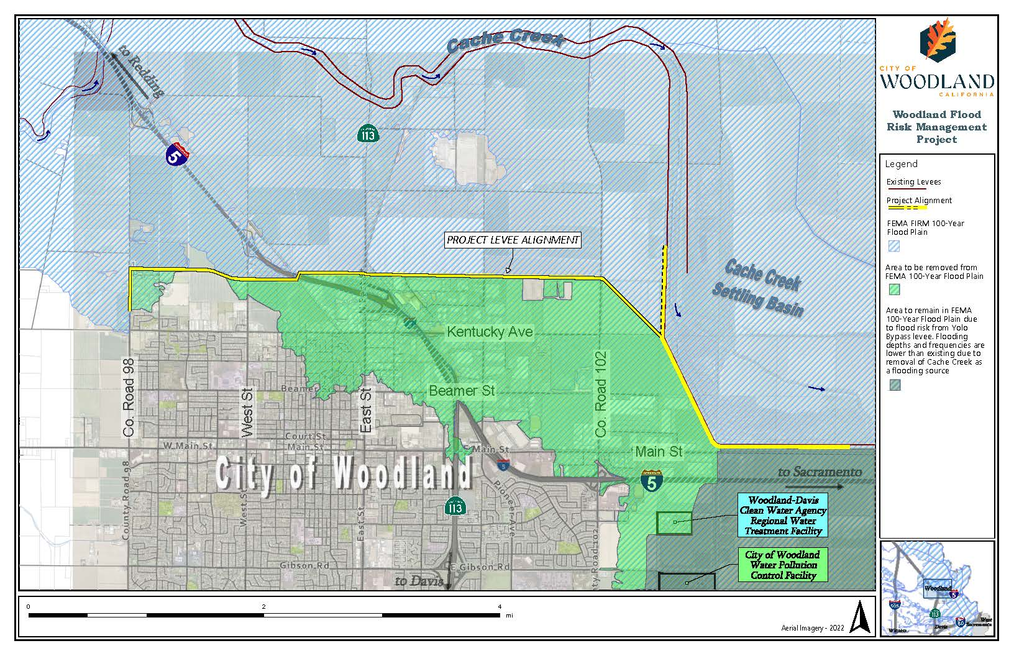
Project Levee Alignment and Residual Floodplains

Slide 12
Looking Ahead...
Project currently in design phase
Construction estimated to being in 2028
Construction expected to take 5-10 years depending on state and federal appropriation process

Slide 13
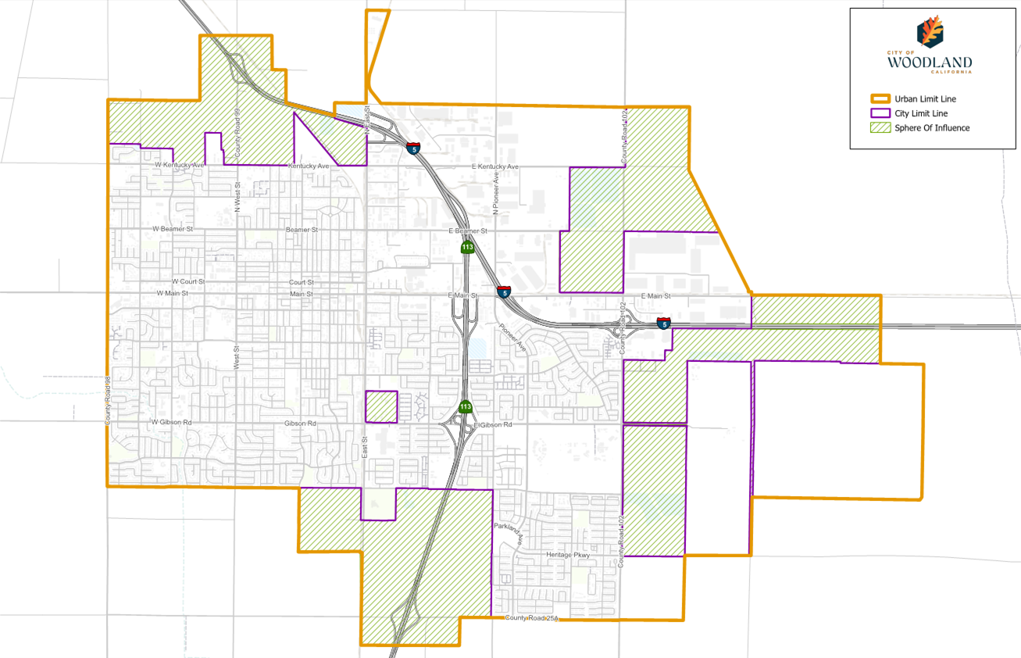
Urban Limit Line
Maximum City Footprint – Approved June 2006

