Slide 1
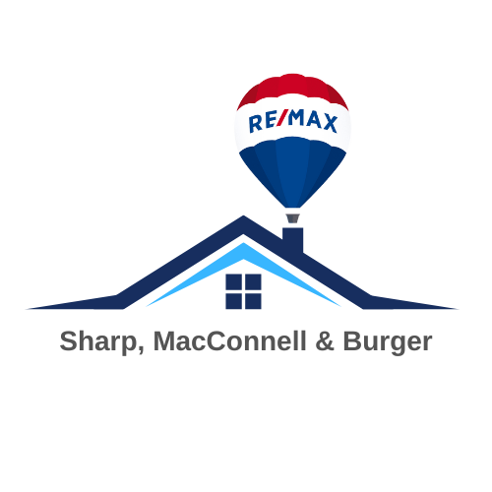
Yolo County Market Update
Don Sharp & Ryan Burger
Sharp, MacConnell and Burger
RE/MAX Gold, Woodland
www.WoodlandHomes.net

Slide 2
Agenda
2025 Summary(Woodland/Davis)
Don Sharp’s Weekly Market Report
Woodland Sales and Volume by Year
Davis Sales and Volume by Year
Woodland vs Davis Graph
Recent Industry Changes

Slide 3
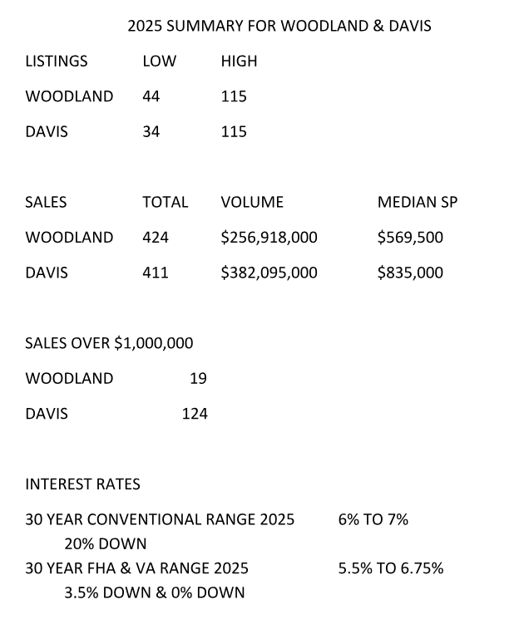
2025 Summary: Woodland & Davis

Slide 4

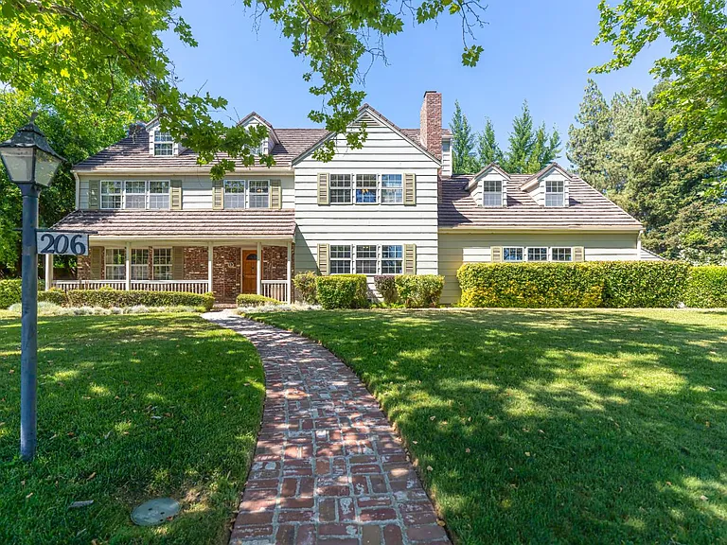
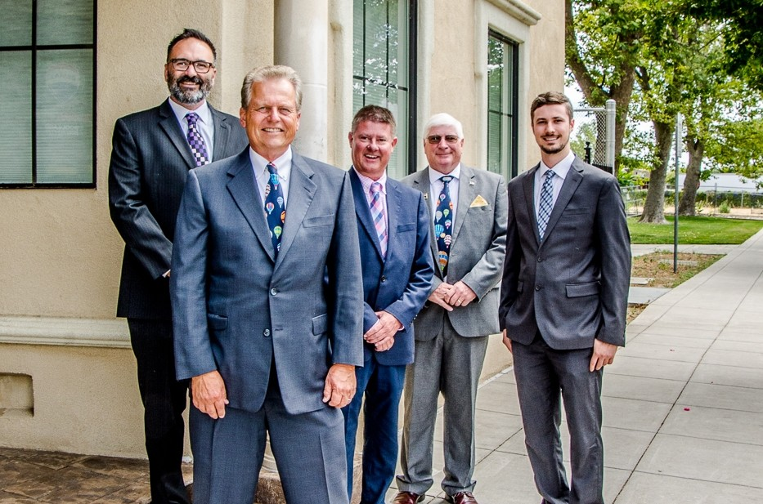
We do Residential!

Slide 5
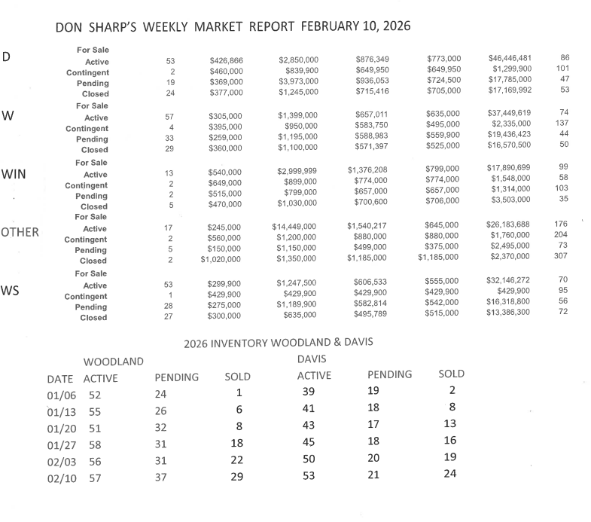
Don Sharp’s Weekly Market Report

Slide 6
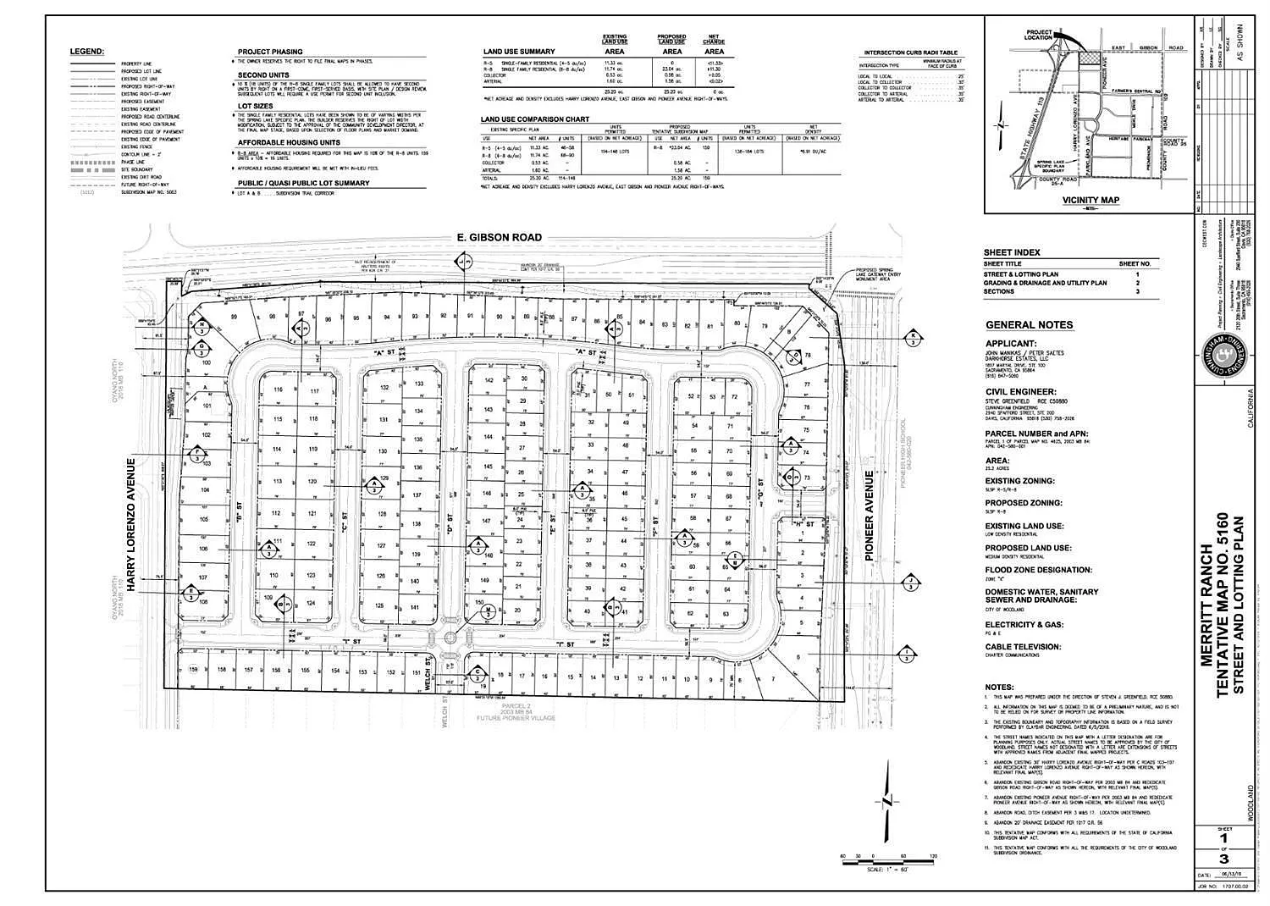
We Do Land!

Slide 7
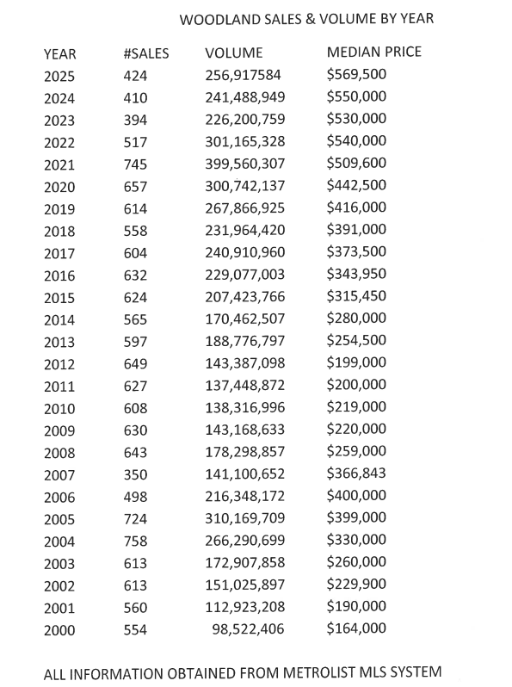
Woodland Sales and Volume by Year

Slide 8
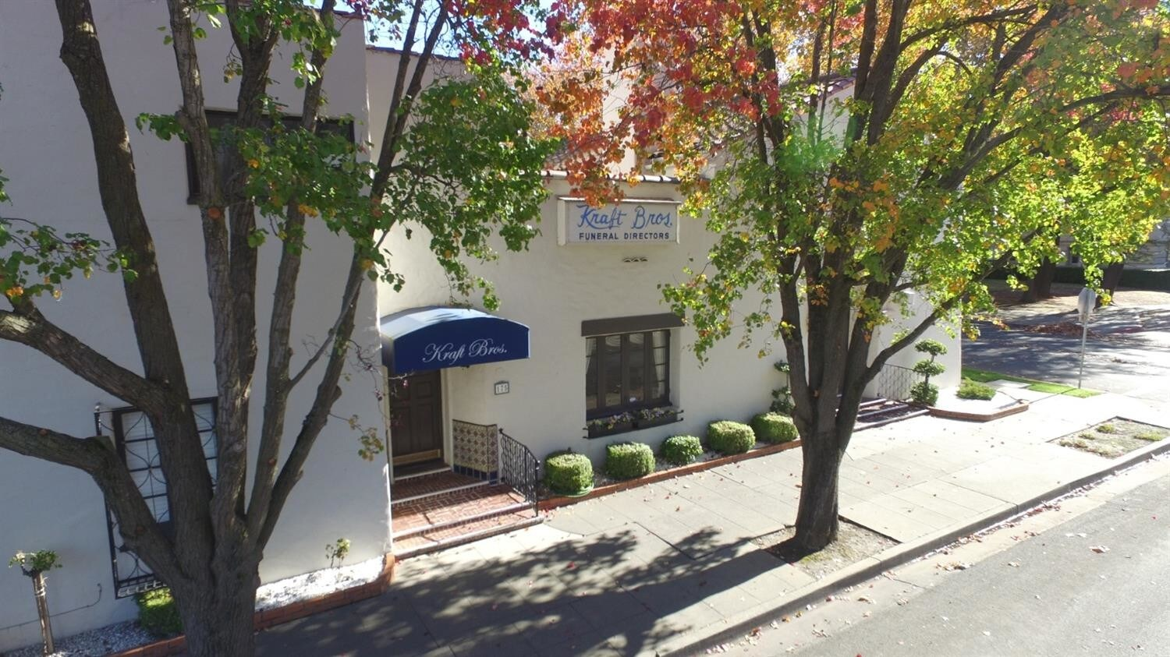
We Do Commercial!

Slide 9
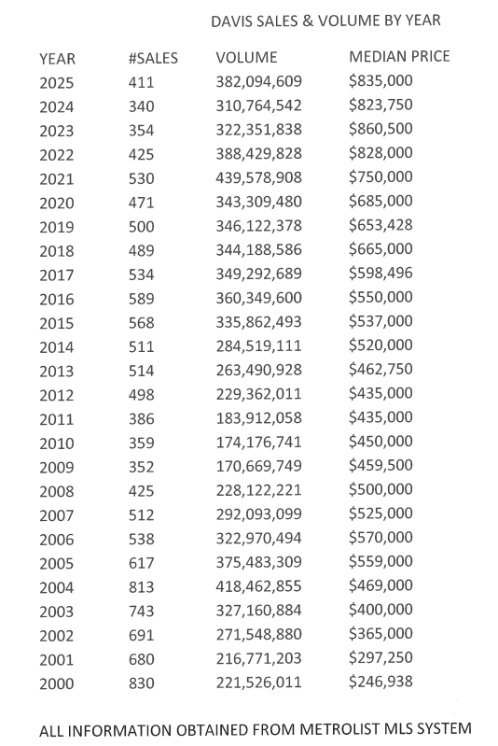
Davis Sales and Volume by Year

Slide 10
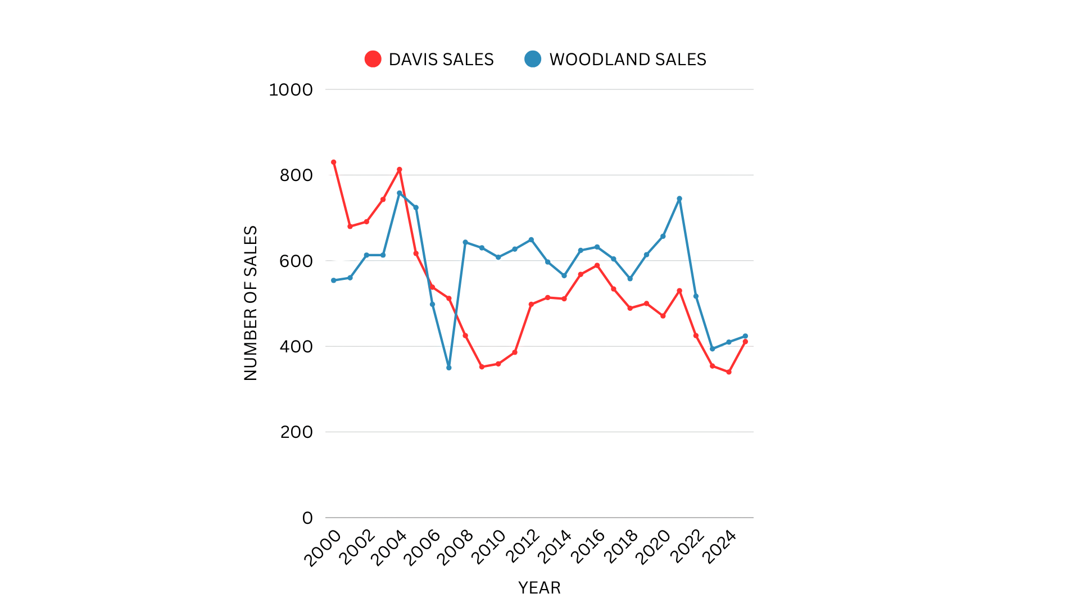
Woodland vs Davis Graph

Slide 11
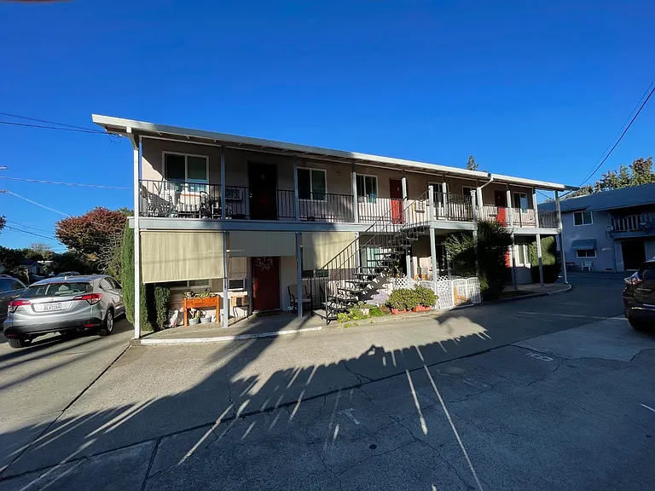
We Do Investment Properties!

Slide 12
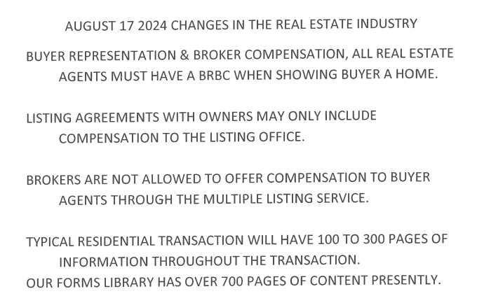
Recent Industry Changes

Slide 13
Questions?
Sharp, MacConnell & Burger
927 Main Street, Woodland
(530)661-7777
Donsharp927@yahoo.com
www.woodlandhomes.net

