Slide 1
We Can Do More than Say, “Thank You for Your Service”
Rosanne (Bergh) Callens, MHR
Career and Education Program Manager
Travis Air Force Base

Slide 2
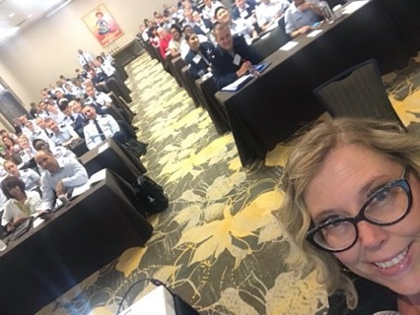
Beale AFB, CA Azores, Portugal Minot AFB, ND Azores, Portugal Ramstein, Germany Alconbury, UK Defense Language Institute & Naval Postgraduate School, Monterey, CA Naval Base Coronado, Point Loma, Lemoore USMC Camp Pendleton, CA Travis, CA
Who I am
Teacher
Dept of Defense Consultant
Dept of Labor Consultant
LinkedIn Branding
Career Coach
Professional Development Workshops
Helping Veterans ALL Over the World
I get to help people EVERY DAY!

Slide 3
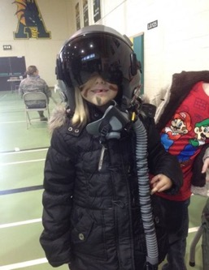
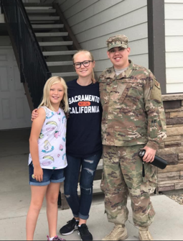
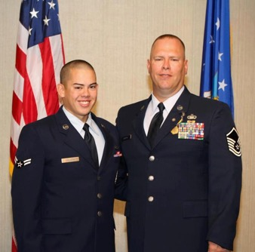
A little about my “WHY”
Emma, 15
Future Intelligence Analyst
Woodland High School
Sophia, 11
Future Pilot or Meteorologist
for US Space Force
Whitehead Elementary
Staff Sergeant Daniel Callens
Combat Communications
Cyber Security
Minot, North Dakota > Moving
Charlotte, NC
Air Force Family

Slide 4
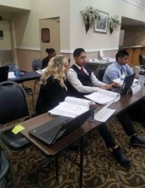
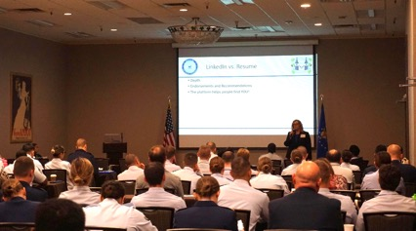
In 2017, I was tired of being told I “SHOULD” be
on LinkedIn!
I decided to look into the hype.
The rest is history!

Slide 5
Travis AFB has approximately 1,500 service members separate/retire from service every year!
Everyone MUST leave the military at some point
It’s my job to help them prepare (successfully) for the transition
A Service Member (SM) can separate or retire (20yrs +) from service
John S. McCain. National Defense Authorization Act 2019
Step 1 Initial Counseling (One-on-One Coaching Session)
Must attend this 365 Days prior to separation and 2 years in advance of military retirement.
We listen to their needs & sign them up for classes/appointments
Step 2 Pre-Separation Workshop (Resources/Recruiters)
Step 3 Transition Assistance Program (TAP) Workshop
Each branch of service holds their specific Day 1
Veteran’s Administration – Day 2
Department of Labor Employment Workshop – Days 3
* Additional/Optional “Tracks”
Boots to Business- Small Business Administration (Addt’l 2 Days)
Vocational Career Exploration Track (Addt’l 2 Days)
Higher Education/Post 9/11 GI Bill Track (Addt’l 2 Days)
Step 4 Capstone (Before they leave service, they turn in their Career Readiness Standards/Service Deliverables)
The Transition Process

Slide 6
Many different jobs Acronyms & Translating “Military to Civilian-ese”
Challenge – What to DO?
PCS
LES
BAS & BAH/OHA
BLUF
NCO
SNCO
WING COMMANDER
IN- THEATER
EXERCISE
SQUADRON
FIRST SHIRT
SUPERINTENDENT
CCAF
NCOA
SOS
EOD
V/R
HHG

Slide 7
They wear too many hats
Command Master Chief (CMC) from Woodland . . .
The CMC is the most senior enlisted sailor in a United States Navy unit. The CMC works as a liaison between the commanding officer and the enlisted ranks.
Career he wanted: Aviation Boatswain Launch and Recovery
Due to his mother’s influence… Had to Enlist in Aviation Maintenance Administration
Still serving after 27 years!

Slide 8
Expectation vs. Reality *Real stories from LinkedIn connections
Military Police Officer = Mortars Platoon Leader
Linguist = Weapons Loader
Graphics Art/Design = C-130 Mechanic
Information Technology = Medical Administration
Public Affairs = Munitions (bullets) Management
Intelligence = Recruiting
Broadcast Journalism = Aircraft Carrier Radioman
Laboratory Technician = HR Specialist
Aircraft Maintainer = Vehicle Maintenance
Pilot = Linguist
Finance = Medical
Underwater Construction Diver = Transportation Operator
Linguist = Combat Medic
IT = Security Forces (Police)
Combat Arms = HR
Combat Medic = Air Traffic Control
Legal or medical = Truck Driver
Careers in the Military

Slide 9
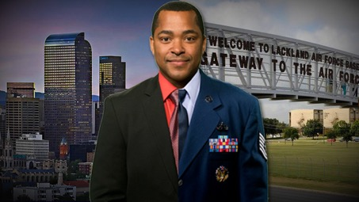
How YOU Can Help

Slide 10
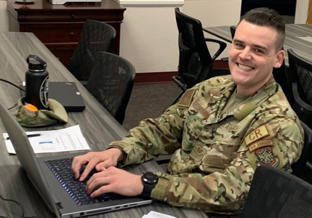
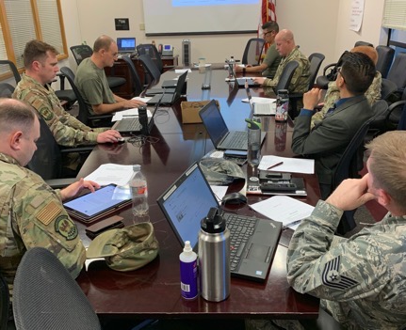
Veterans feel very awkward networking outside the military bubble!
How YOU Can Help
Smiling with RELIEF!
Help by talking/giving advice
Spending time reaching out to professionals!

Slide 11
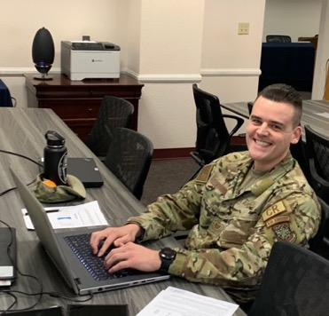
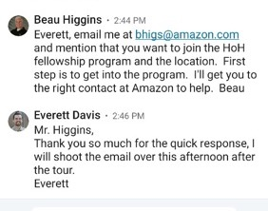
Real LinkedIn Stories (Notice the message response time)

Slide 12
Real Stories, Real People

Slide 13
Special Agent, Diplomatic Security Service
RESULT:
WAY MORE THAN THE
“ONE TIP” THAT I REQUESTED!
I WAS ABLE TO CONNECT HIM WITH THE VETERAN THE NEXT DAY!

Slide 14
How YOU Can Help
YOU can help an active duty veteran get a DoD Skillbridge Internship up to 6 months before they leave military service.
This program allows transitioning service members (whether they are retiring or separating) to spend their last 6 months in uniform working in a “civilian” job!
Want to know more as an employer?
https://dodskillbridge.usalearning.gov/industry-employers.htm

Slide 15
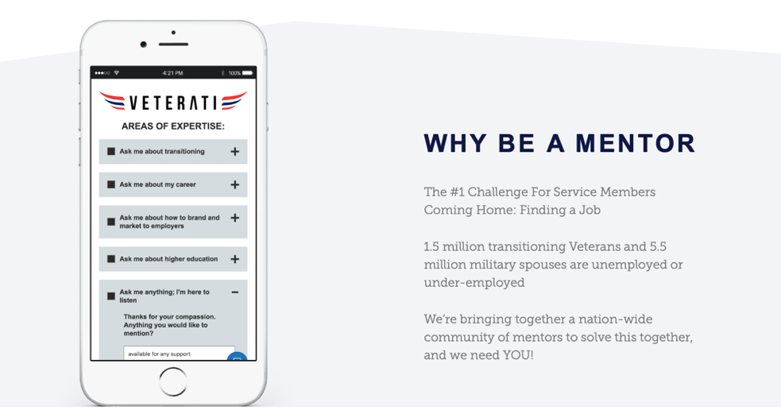
www.veterati.com

Slide 16
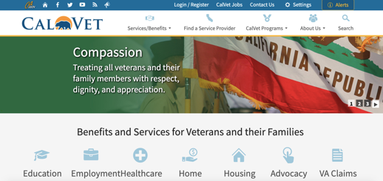
Important resource for ANY Veterans
The College Fee Waiver for Veteran Dependents benefit waives mandatory system-wide tuition and fees at any State of California Community College, California State University, or University of California campus. This program does not cover the expense of books, parking or room and board.
County Veteran Service Office locations in California
https://www.calvet.ca.gov/VetServices/Pages/CVSO-Locations.aspx
A ZERO PERCENT RATING is STILL A DISABILITY RATING!
If you (or any veteran you know) want to attend a Zoom CALVET workshop, we have one coming up July 10th from 10:00-1:00 p.m. You can sign up by clicking here or contacting Rosanne Callens at rosannecallens@gmail.com
https://tockify.com/travisafrc/detail/89/1591369200000/9
www.calvet.ca.gov

Slide 17
It’s okay to say, “Thank you for your service” Now there are a few more ways you can express your thanks.
Rosanne Callens ~ 831-201-8722 ~ www.linkedin.com/in/rosannecallens/
THANK YOU for the opportunity to present today!
Rosanne Callens ~ 831-201-8722 ~ rosannecallens@gmail.com www.linkedin.com/in/rosannecallens

