Slide 1

Modern Public Defense
2023
Tracie Olson
Chief Public Defender

Slide 2

Who We Are
51* employees
26 attorneys; 6 investigators; 4 social workers; 4 paralegals
11 support staff; + volunteers
(*includes grant funded positions)
63% identify as women
46% attorneys & 75% supervisors/managers
41% identify as persons of color
35% attorneys & 42% supervisors/managers
29% speak a language other than English

Slide 3

Our MISSION is to provide quality legal representation through zealous advocacy that protects the liberty and constitutional rights of our clients and ensures a fair system of justice.
We believe in treating every client with compassion and respect, striving to be client-centered in our work.
We advise clients holistically and assist them with necessary supports and services to address both their legal and social support needs.

Slide 4
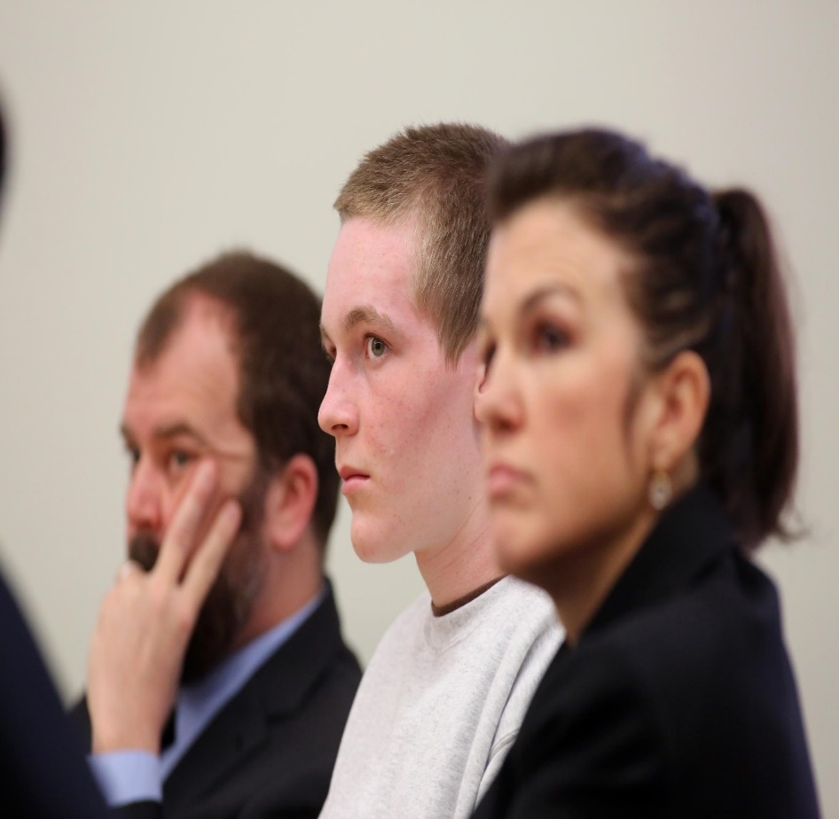
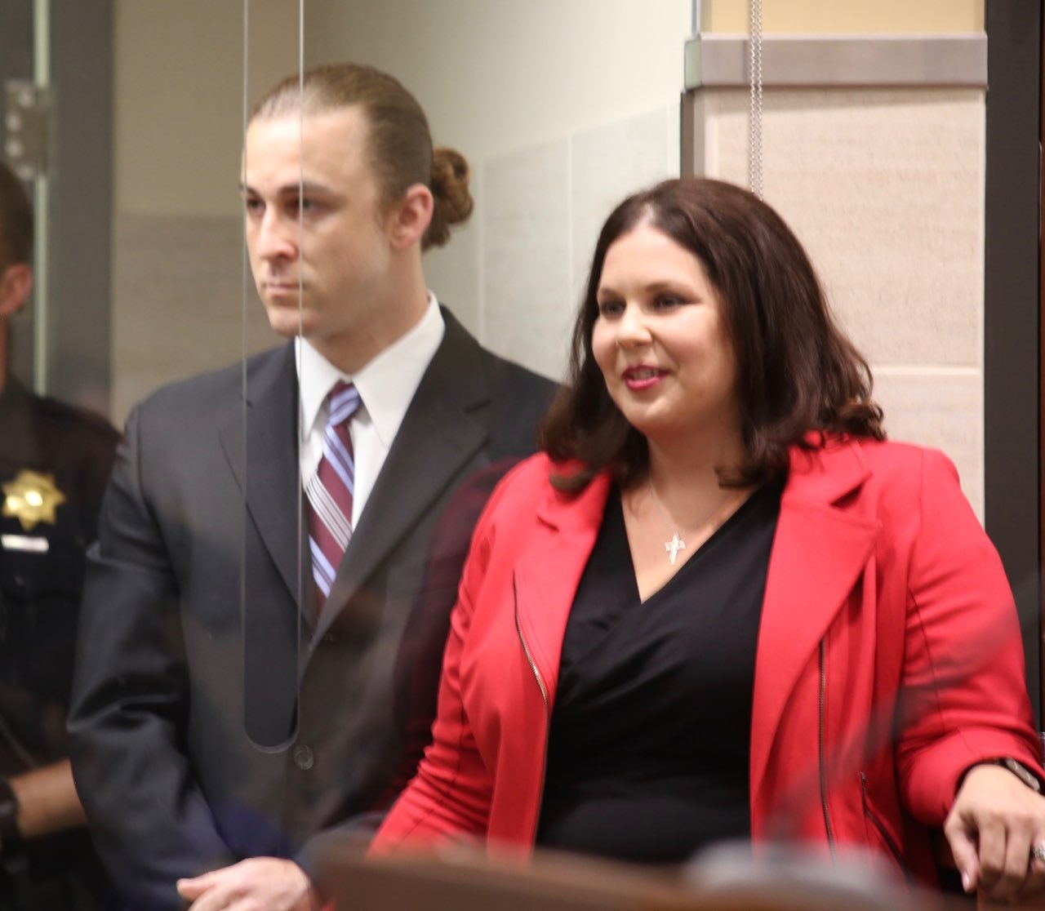
First and Foremost, We Are Litigators
Appointed to approximately 4,000 new adult and adolescent cases, post-conviction matters, and violation of supervision matters in 2022.

Slide 5

We Are Attorneys For The Defense
“I have lived my life and fought my battles
not against the weak and the poor,
but against power, injustice and oppression;
I have asked no odds from them and never shall.
I am an attorney for the defense.“
– Clarence Darrow

Slide 6
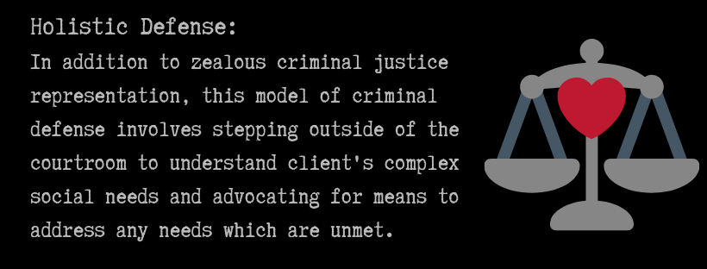
We Practice Holistic Defense

Slide 7
Holistic Defense Services
Mitigation Unit
Social Workers – all Master’s Level Graduates
Assist clients with the issues that originally led to their involvement in the criminal justice system.
Create plans to influence client-centered resolution of criminal cases, which means community re-integration instead of custodial sentence.
Help secure benefits, housing, employment, obtain required medication, refer to mental health and substance use treatment.
Assist youth, determine sources of instability and advocate for proper services to meet youth’s needs in the community.
Advocacy through community outreach and county workgroups.

Slide 8
Adult Mitigation Unit (July-Dec 2022)

Slide 9
Adult Mitigation Unit (July–Dec 2022)

Slide 10
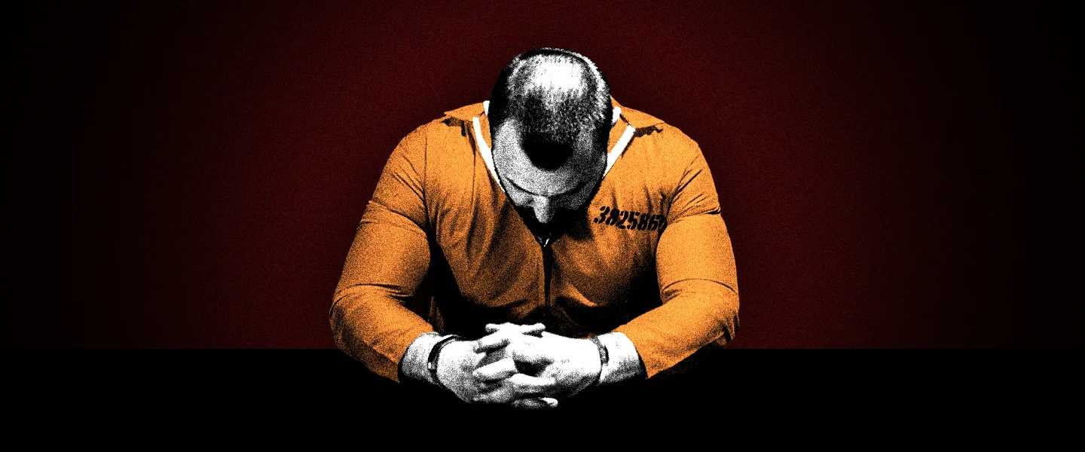
Post-Conviction Unit
Implement new post-conviction laws, to include:
  Modification to felony murder rule,
  Invalid prison and drug priors,
  New rules governing case enhancements,
  Prosecution initiated or CDCR initiated resentencing,
  Immigration vacaturs,
  Preparing clients for youthful offender parole hearings.

Slide 11
Post-Conviction Unit

Slide 12
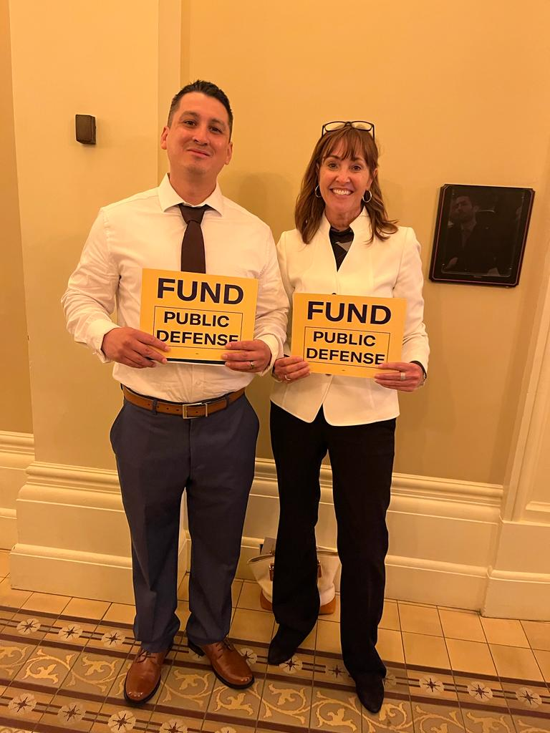
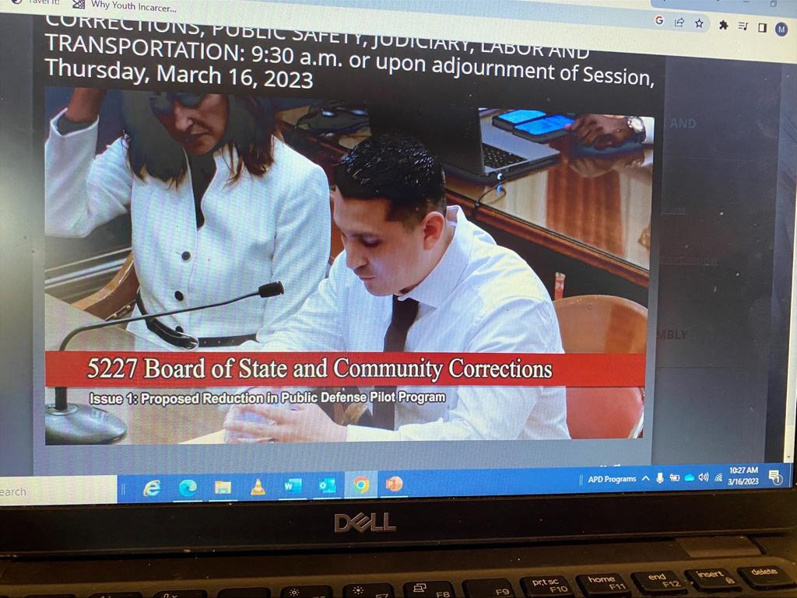
Carlos Hernandez and Me at the Capitol

Slide 13
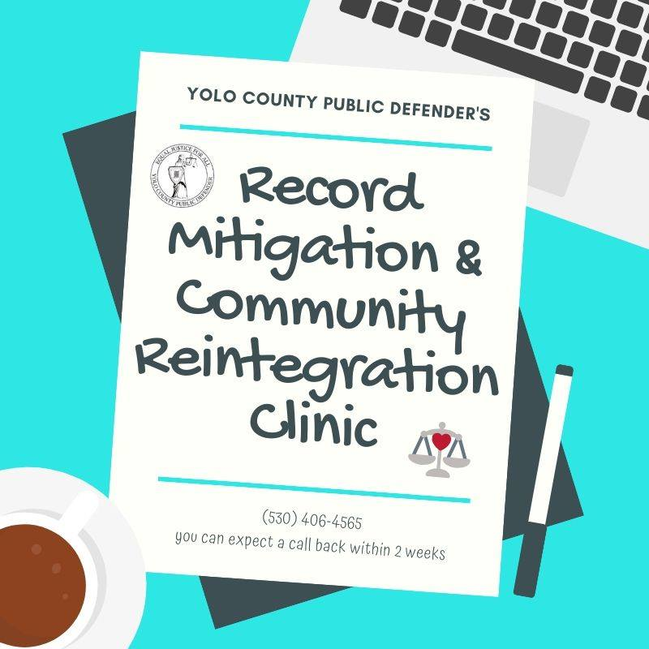
Post-Conviction Unit
As Assist rehabilitated persons clear up th their criminal records after completion o of probation or a custodial sentence, t thereby removing barriers to economic s stability and a return to crime.
Examples include:
*Expungement of a Conviction
*Reduction Felony to a Misdemeanor
C *Certificate of Rehabilitation
*Sealing of Records (adult or juvenile)
*Factual Finding of Innocence
*Removal from Sex Offender Registry

Slide 14
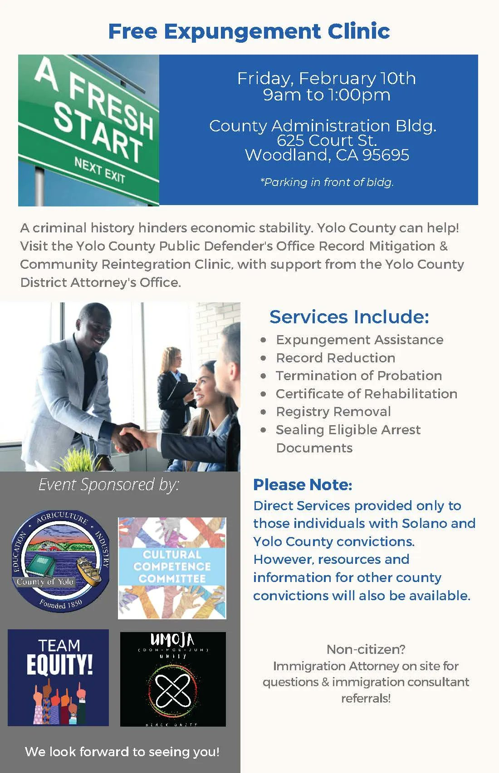
Expungement Clinic & Immigration Consults

Slide 15
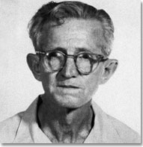
Holistic Defense Services
Immigration Attorney
Avoid deportation and preserve eligibility for forms of federal relief.
In-House Investigators
Investigate defenses, find witnesses and evidence.
Paralegals, Case Preparation Specialist, Analyst, Support Staff

Slide 16
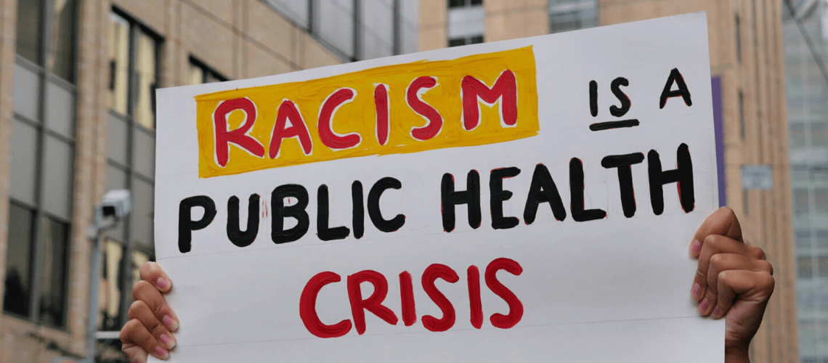
Racial Justice Committee (RJC)
Confront racial inequity and discrimination both in and outside of the courtroom through education, litigation, and advocacy.

Slide 17
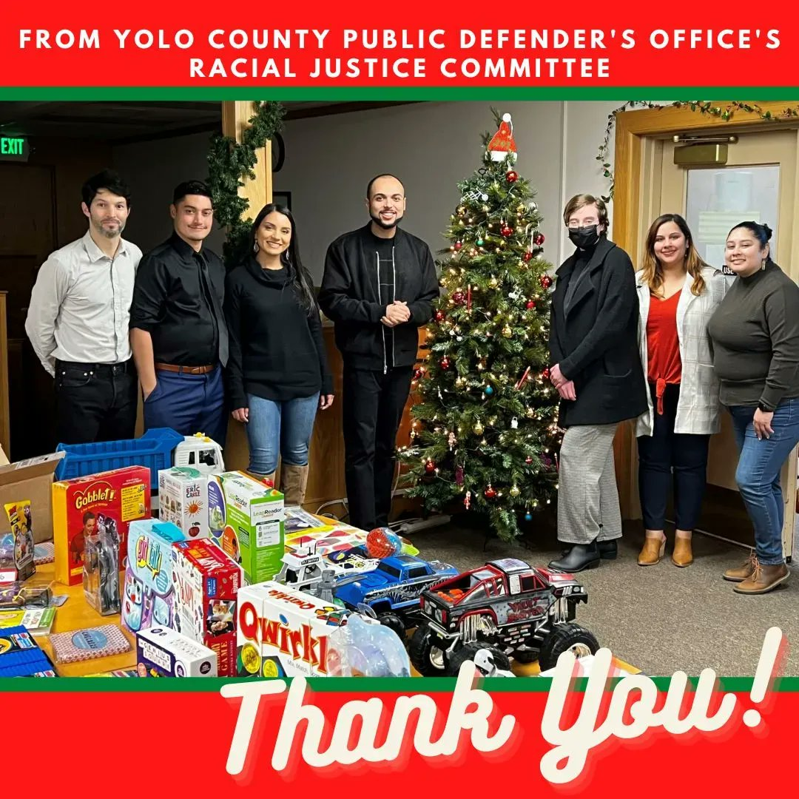
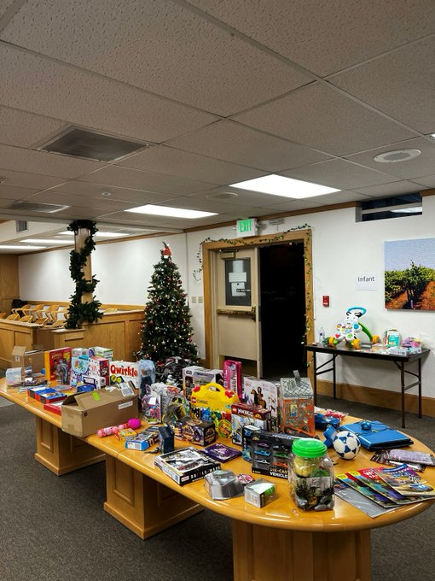
RJC – Holiday Toy Shop Event

Slide 18

Internship Program
Trained.
Supervised.
Mentored.
Write Motions.
Meet Clients.
Go to Court.
Conduct Evidentiary Hearings.
Litigate Jury Trials.

Slide 19
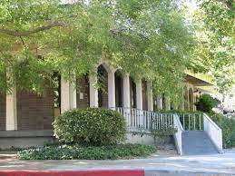
Community Outreach & Programs
Voter Education and
Registration Events
Project Homekey with
West Sac PD
Defenders of Tomorrow
Clothing Drives

Slide 20
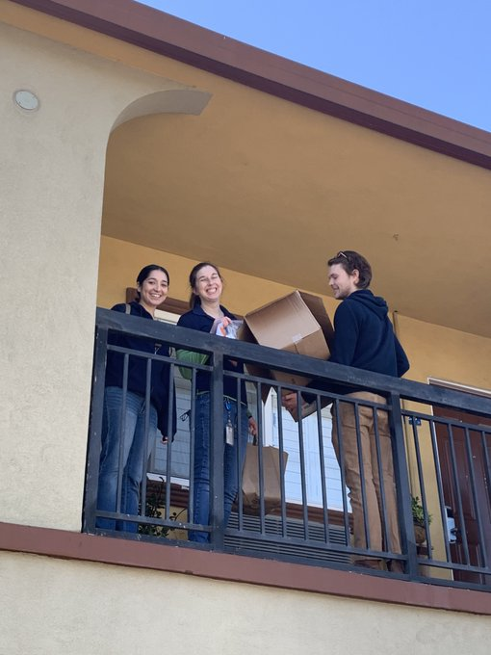
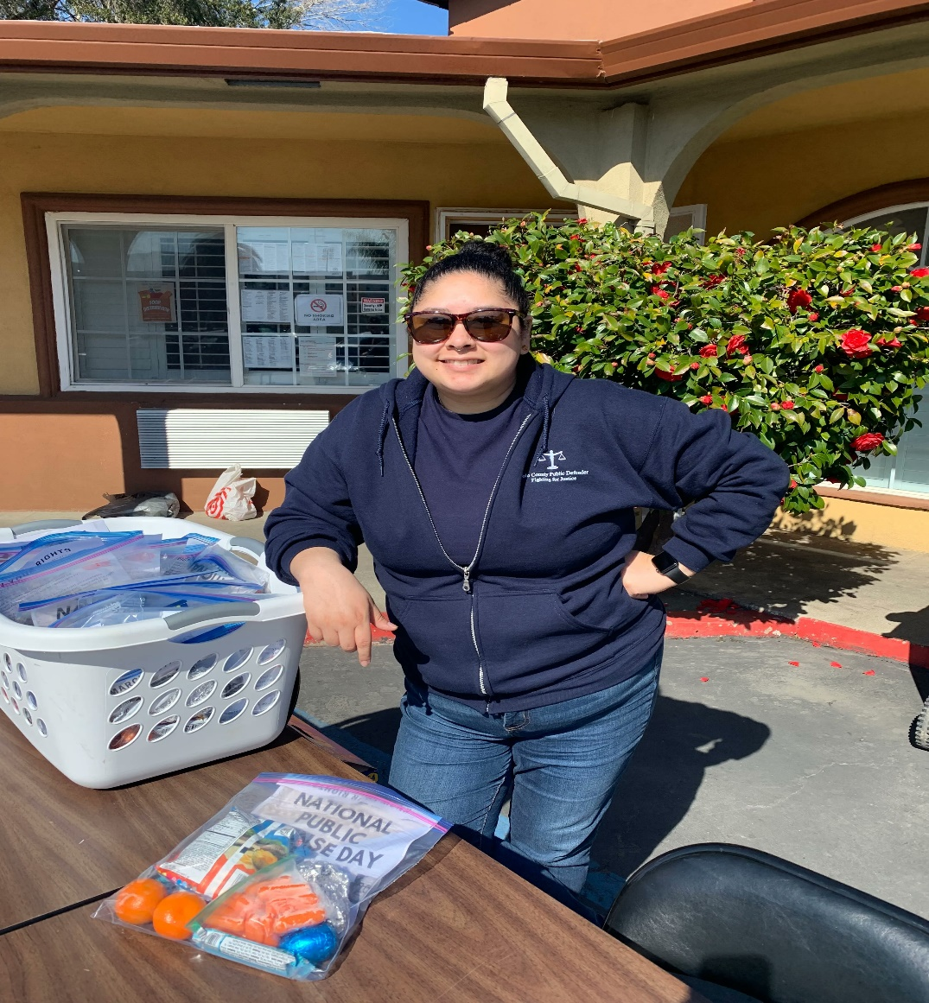
Providing Food Packets at Project Homekey

Slide 21
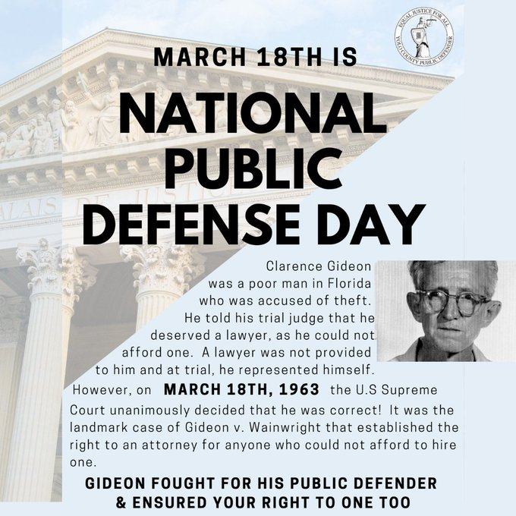
We Educate

Slide 22

We Collaborate
Mental Health Court
Addiction Intervention
Court
Mental Health
Diversion
Medication Assisted
Treatment

Slide 23
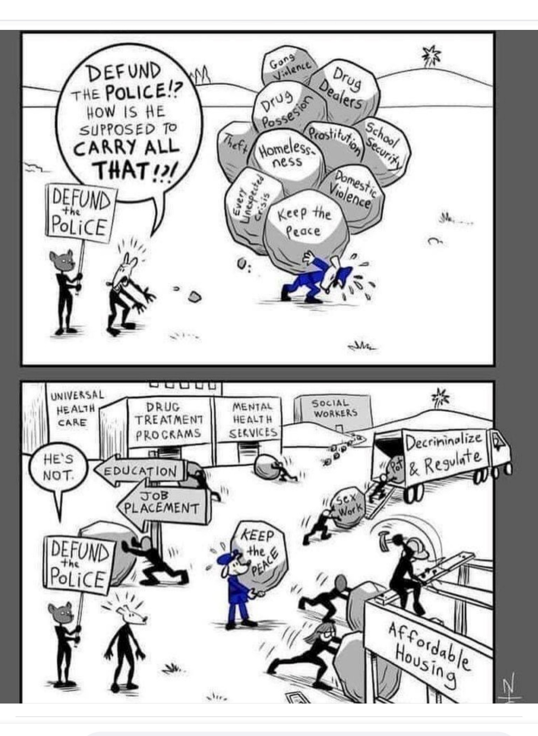
We Advance Client-Centered Ideas

Slide 24


We Care

Slide 25



Contact Us
Yolo County Public Defender’s Office
814 North Street
Woodland, CA 95695
(530) 666-8165
Tracie.Olson@yolocounty.org
Yolo_Public_Defender
@YoloPubDefense
@TracieOlsonPD
YoloPublicDefense

